Slide 1
Deep Learning (CS 898-BD)
Fall 2023
Dr. Shruti Kshirsagar

Slide 2
Contents:Recap of last class
What is CNN? Introduction
Why convnet over feedforward NN
CNN layers
Convolution layer and pooling layer
Fully connected layer
Designing a CNN and how CNN works?
Applications
Advantages of CNN
Limitation of CNN

Slide 3
Contents:Recap of last class
Local connectivity
Parameter sharing
Discrete Convolution
Pooling and subsampling
Generating additional example-Data Augmentation
Imagenet, Resnet, VGGnet-Transfer learning
Batch Normalization
Loss function

Slide 4
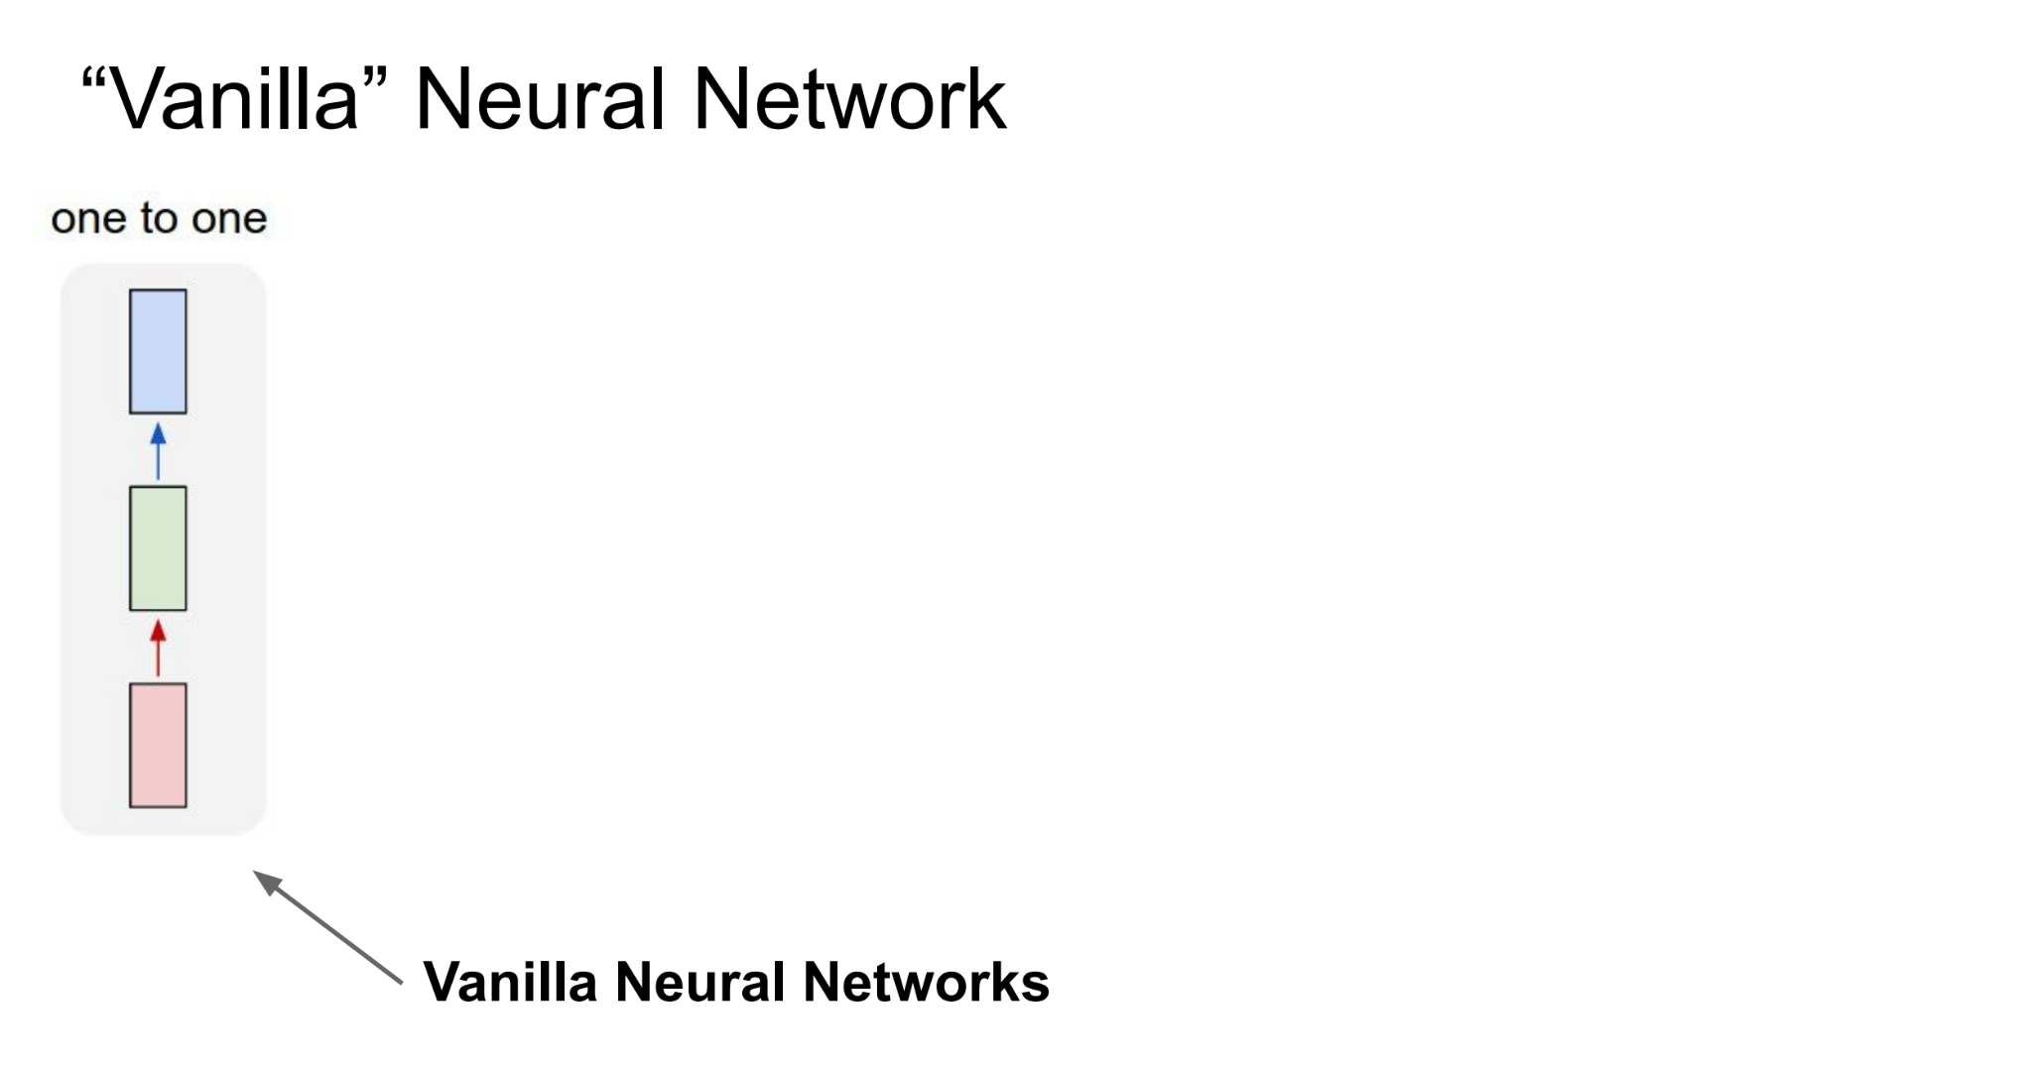
Vanilla Neural Network

Slide 5
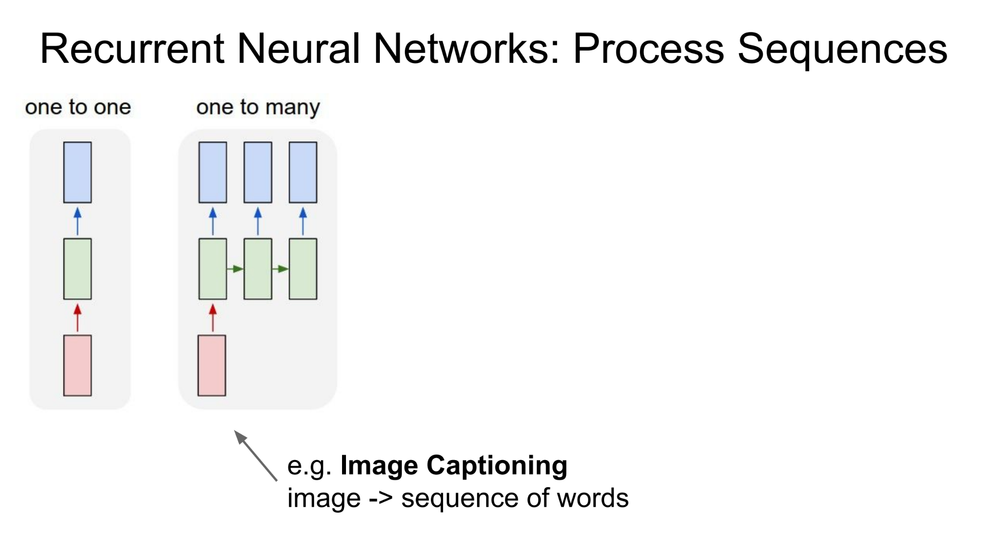
Recurrent Neural Network

Slide 6
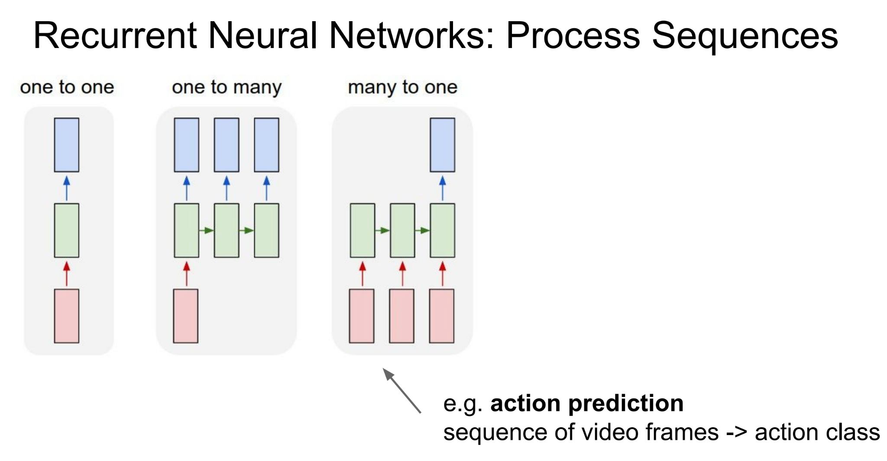
Recurrent Neural Network

Slide 7
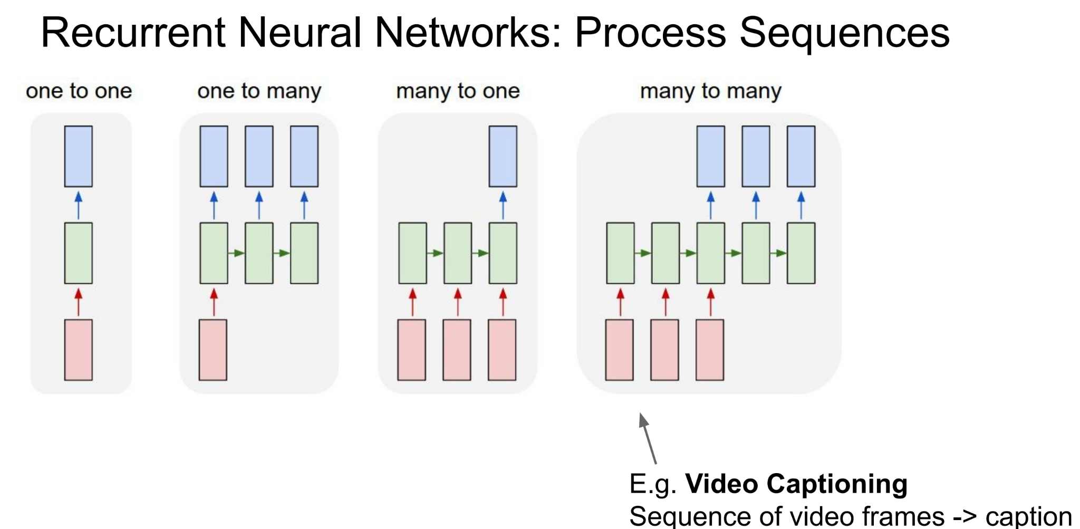
Recurrent Neural Network

Slide 8
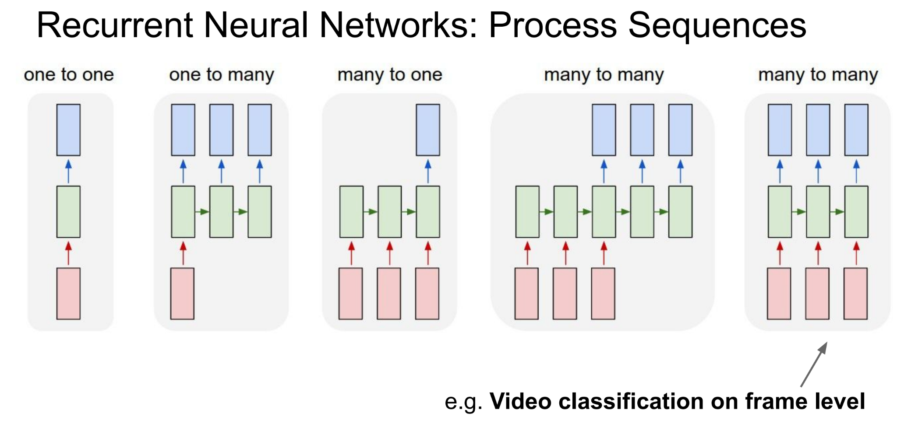
Recurrent Neural Network

Slide 9
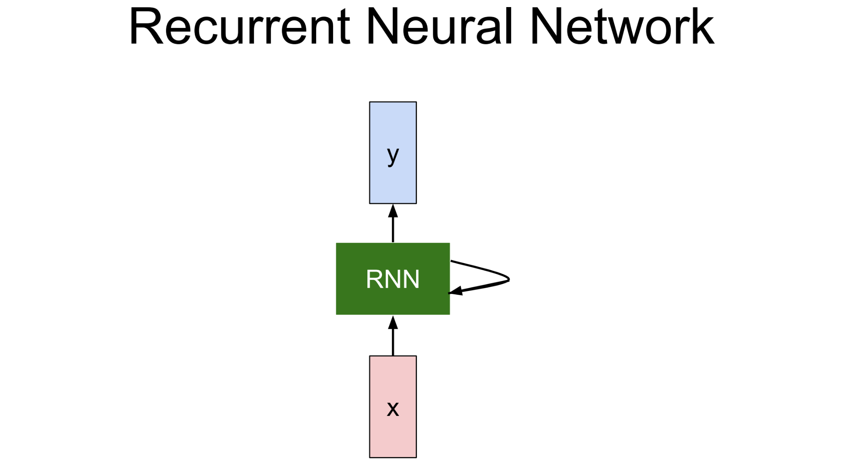
Recurrent Neural Network

Slide 10
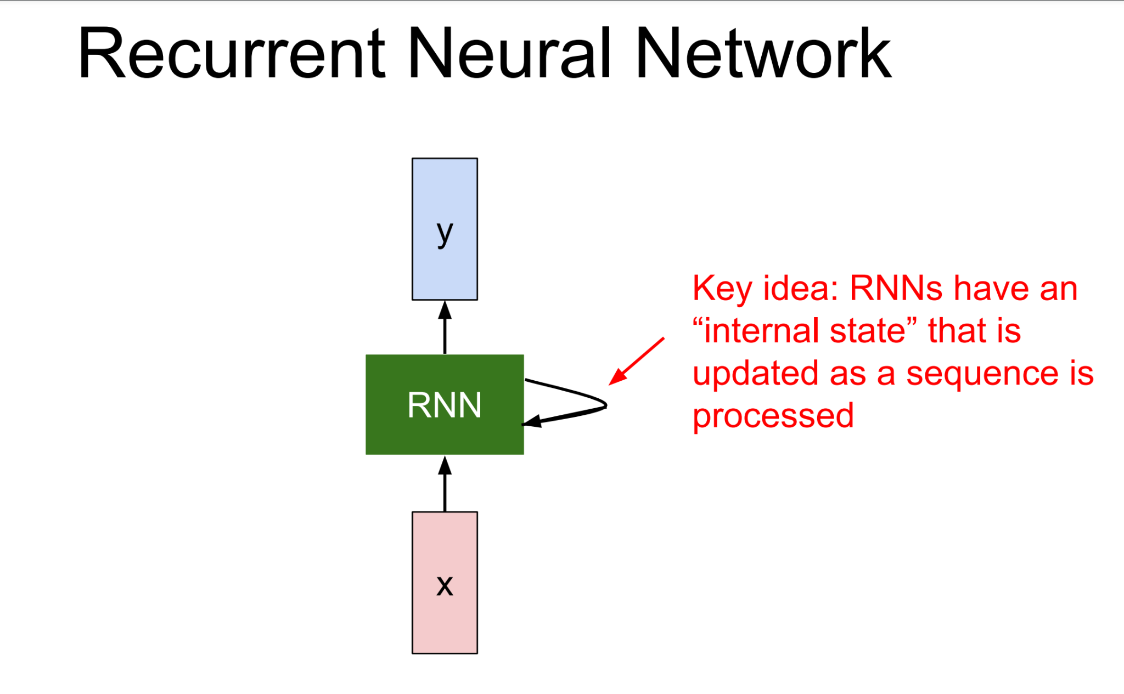
Recurrent Neural Network

Slide 11
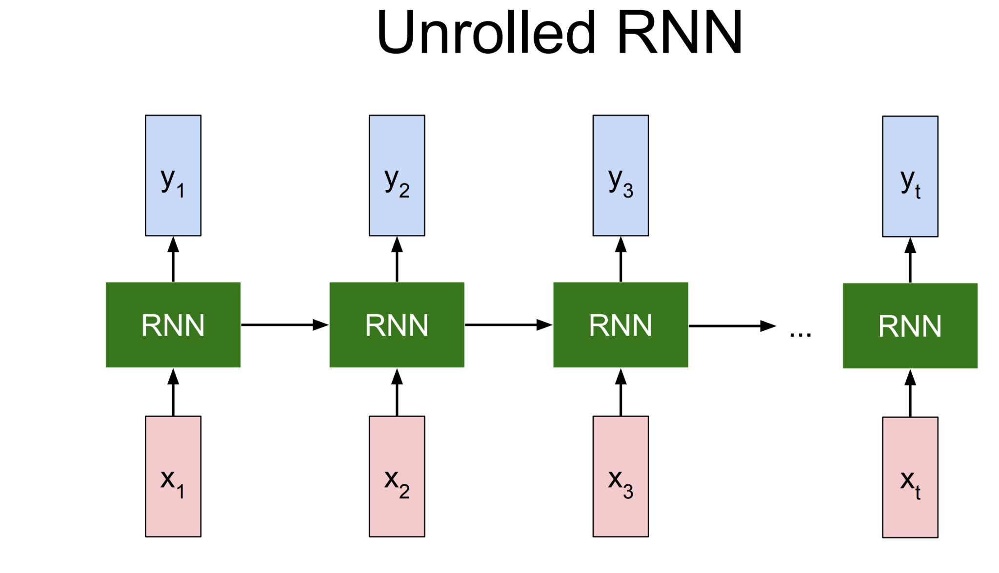
Recurrent Neural Network

Slide 12
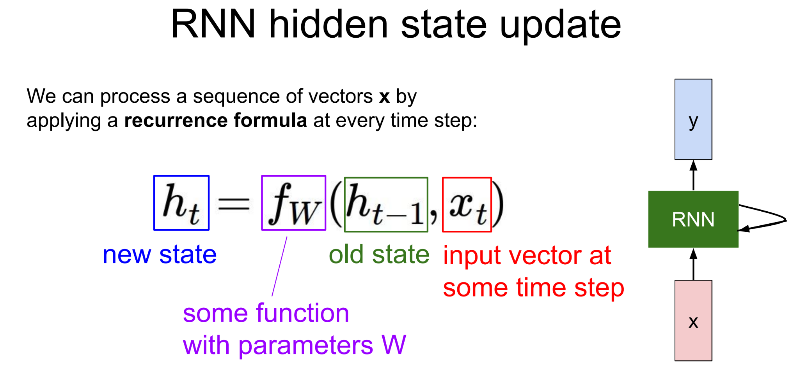
Recurrent Neural Network

Slide 13
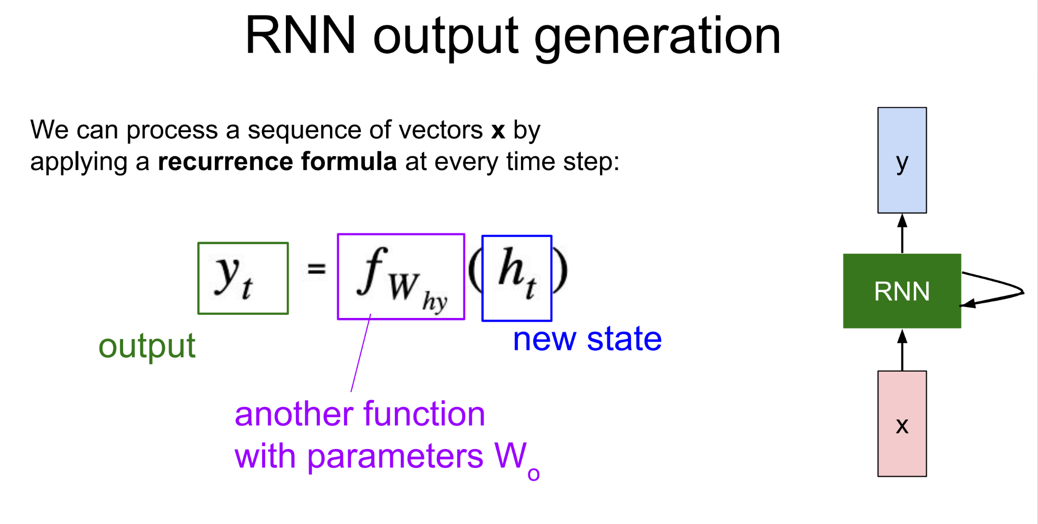
Recurrent Neural Network

Slide 14
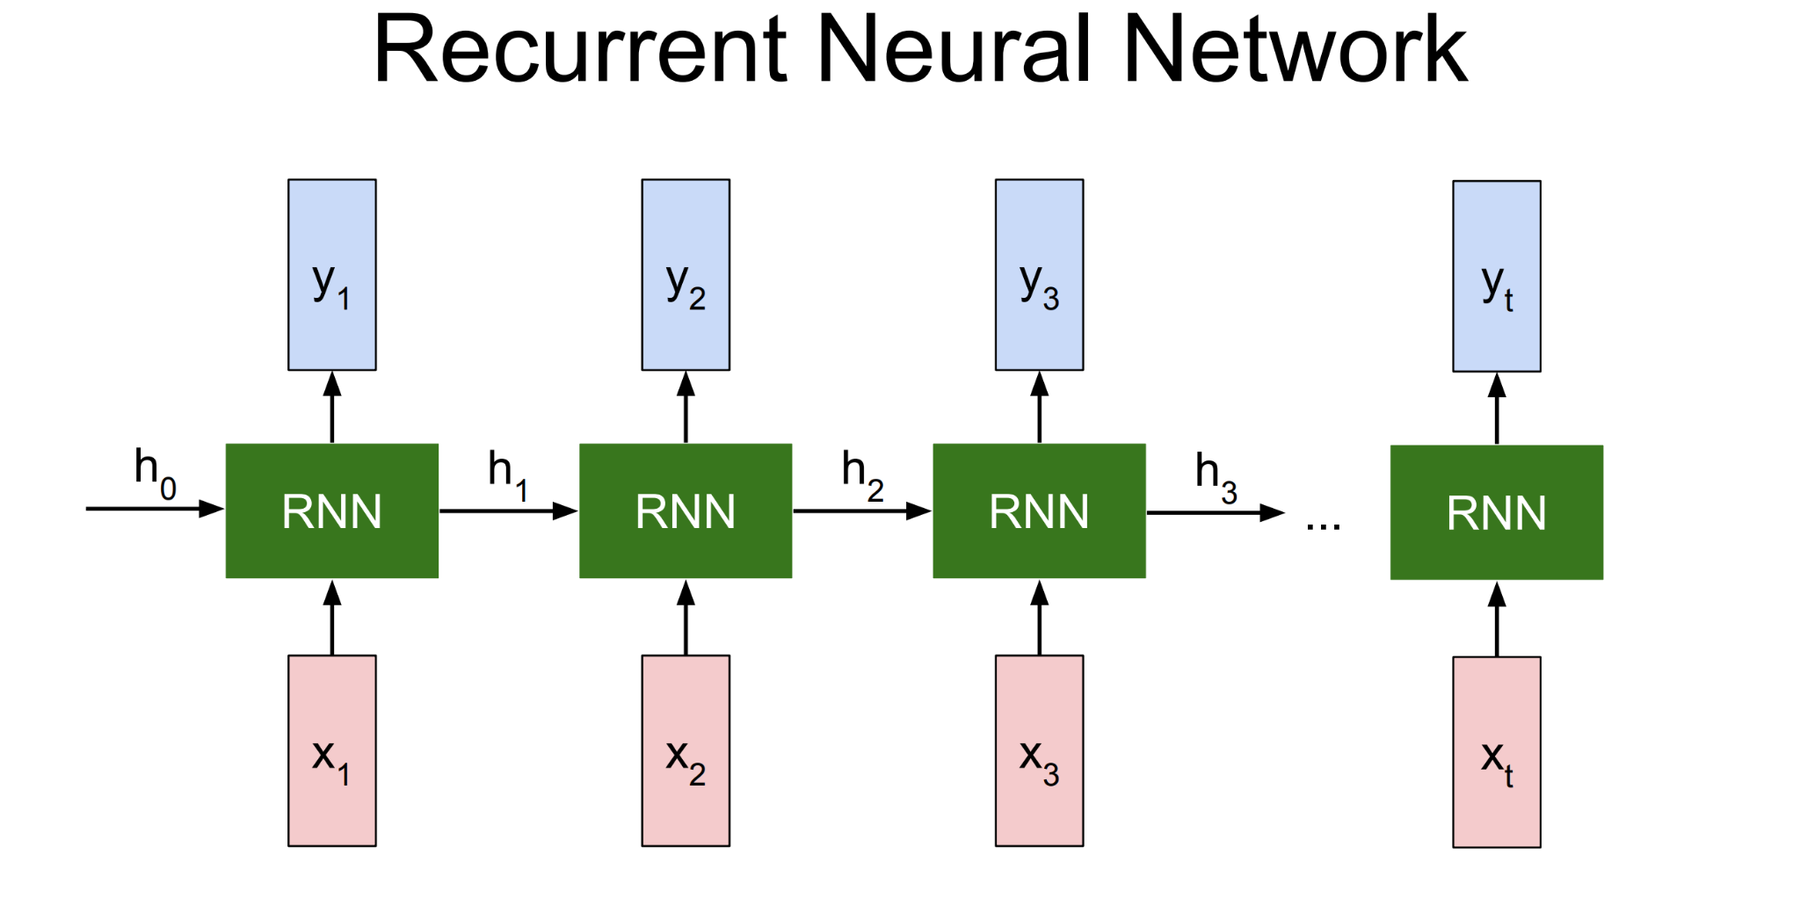
Recurrent Neural Network

Slide 15
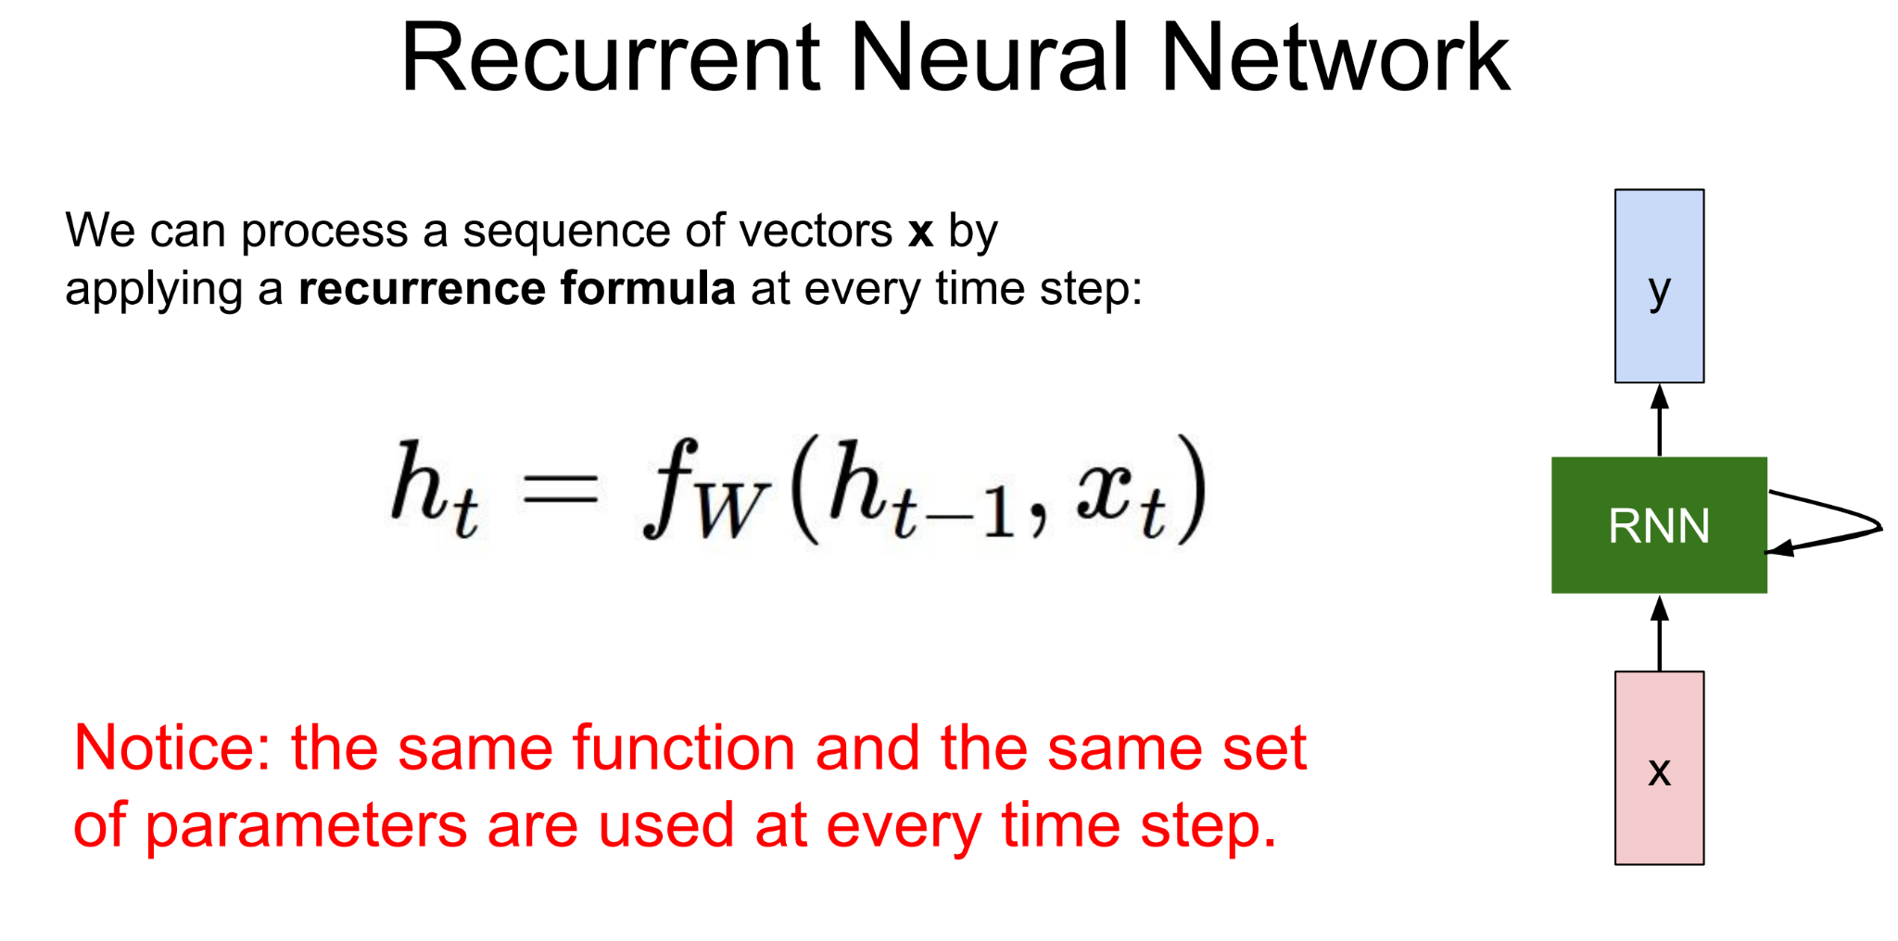
Recurrent Neural Network

Slide 16
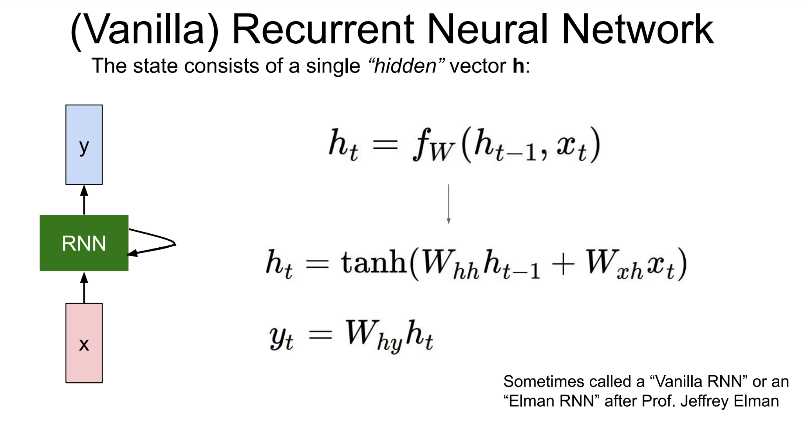
Recurrent Neural Network

Slide 17
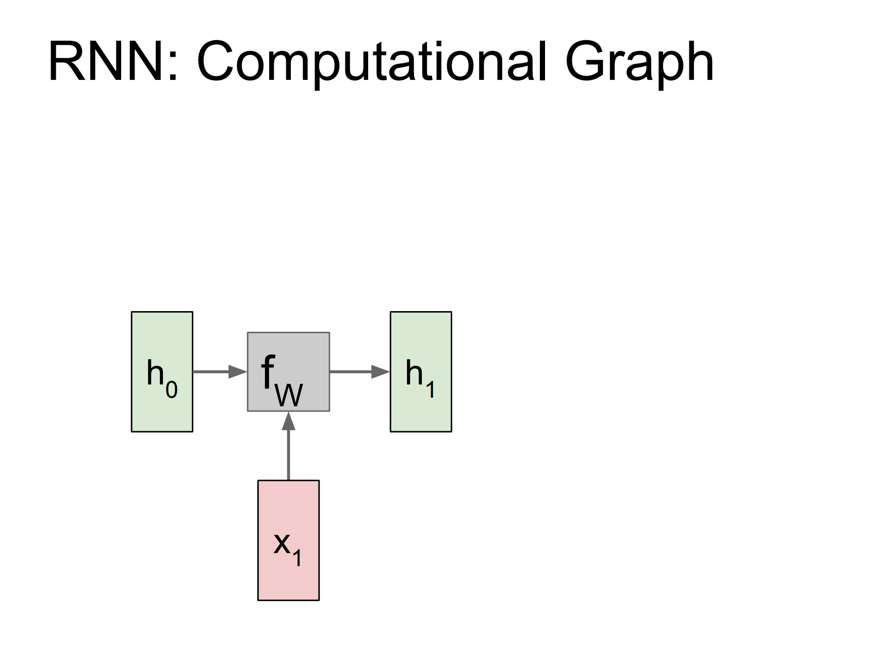
Recurrent Neural Network

Slide 18
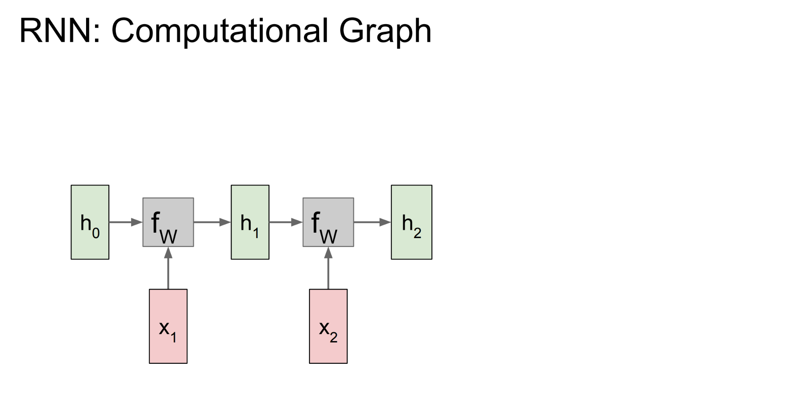
Recurrent Neural Network

Slide 19
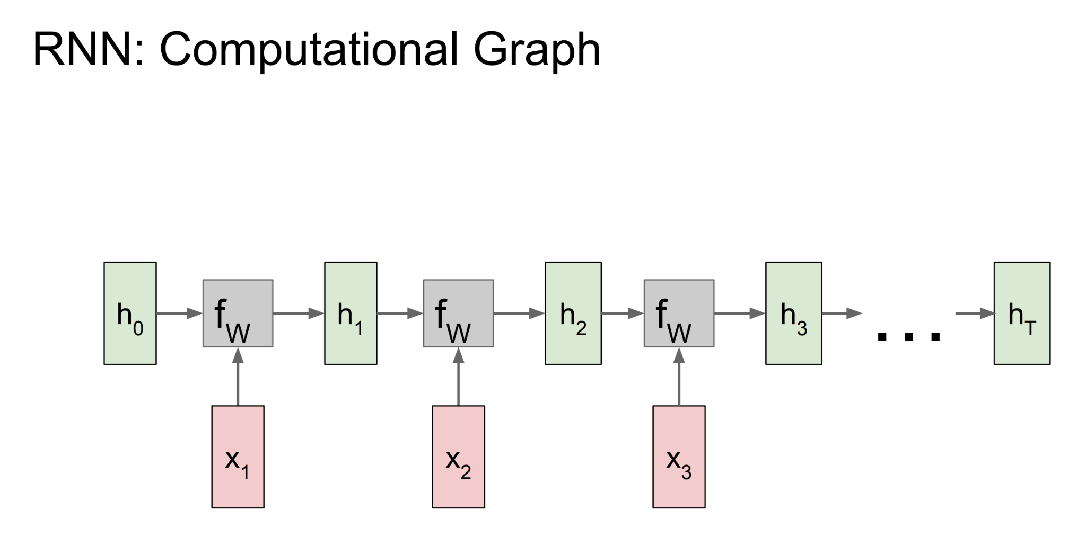
Recurrent Neural Network

Slide 20
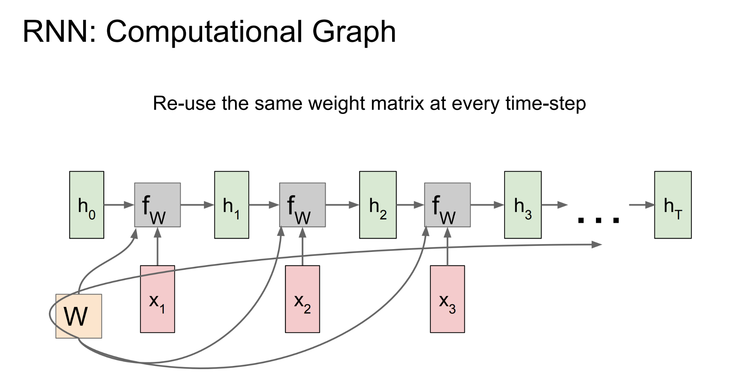
Recurrent Neural Network

Slide 21
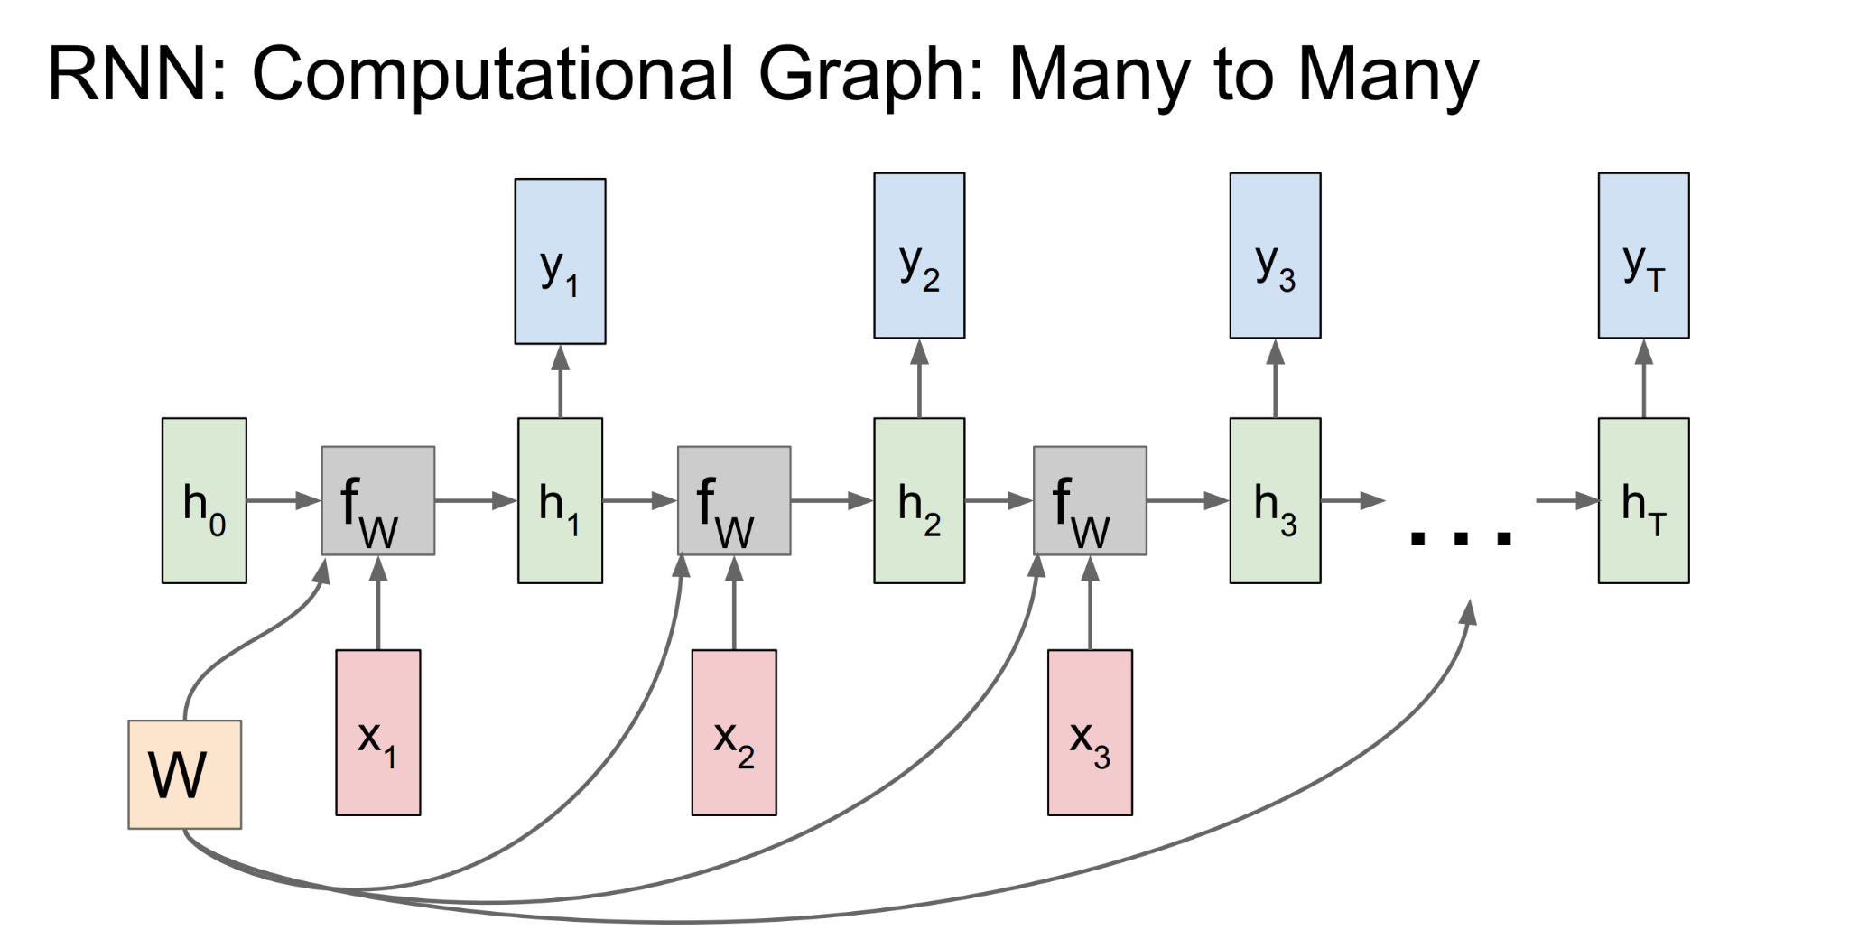
Recurrent Neural Network

Slide 22
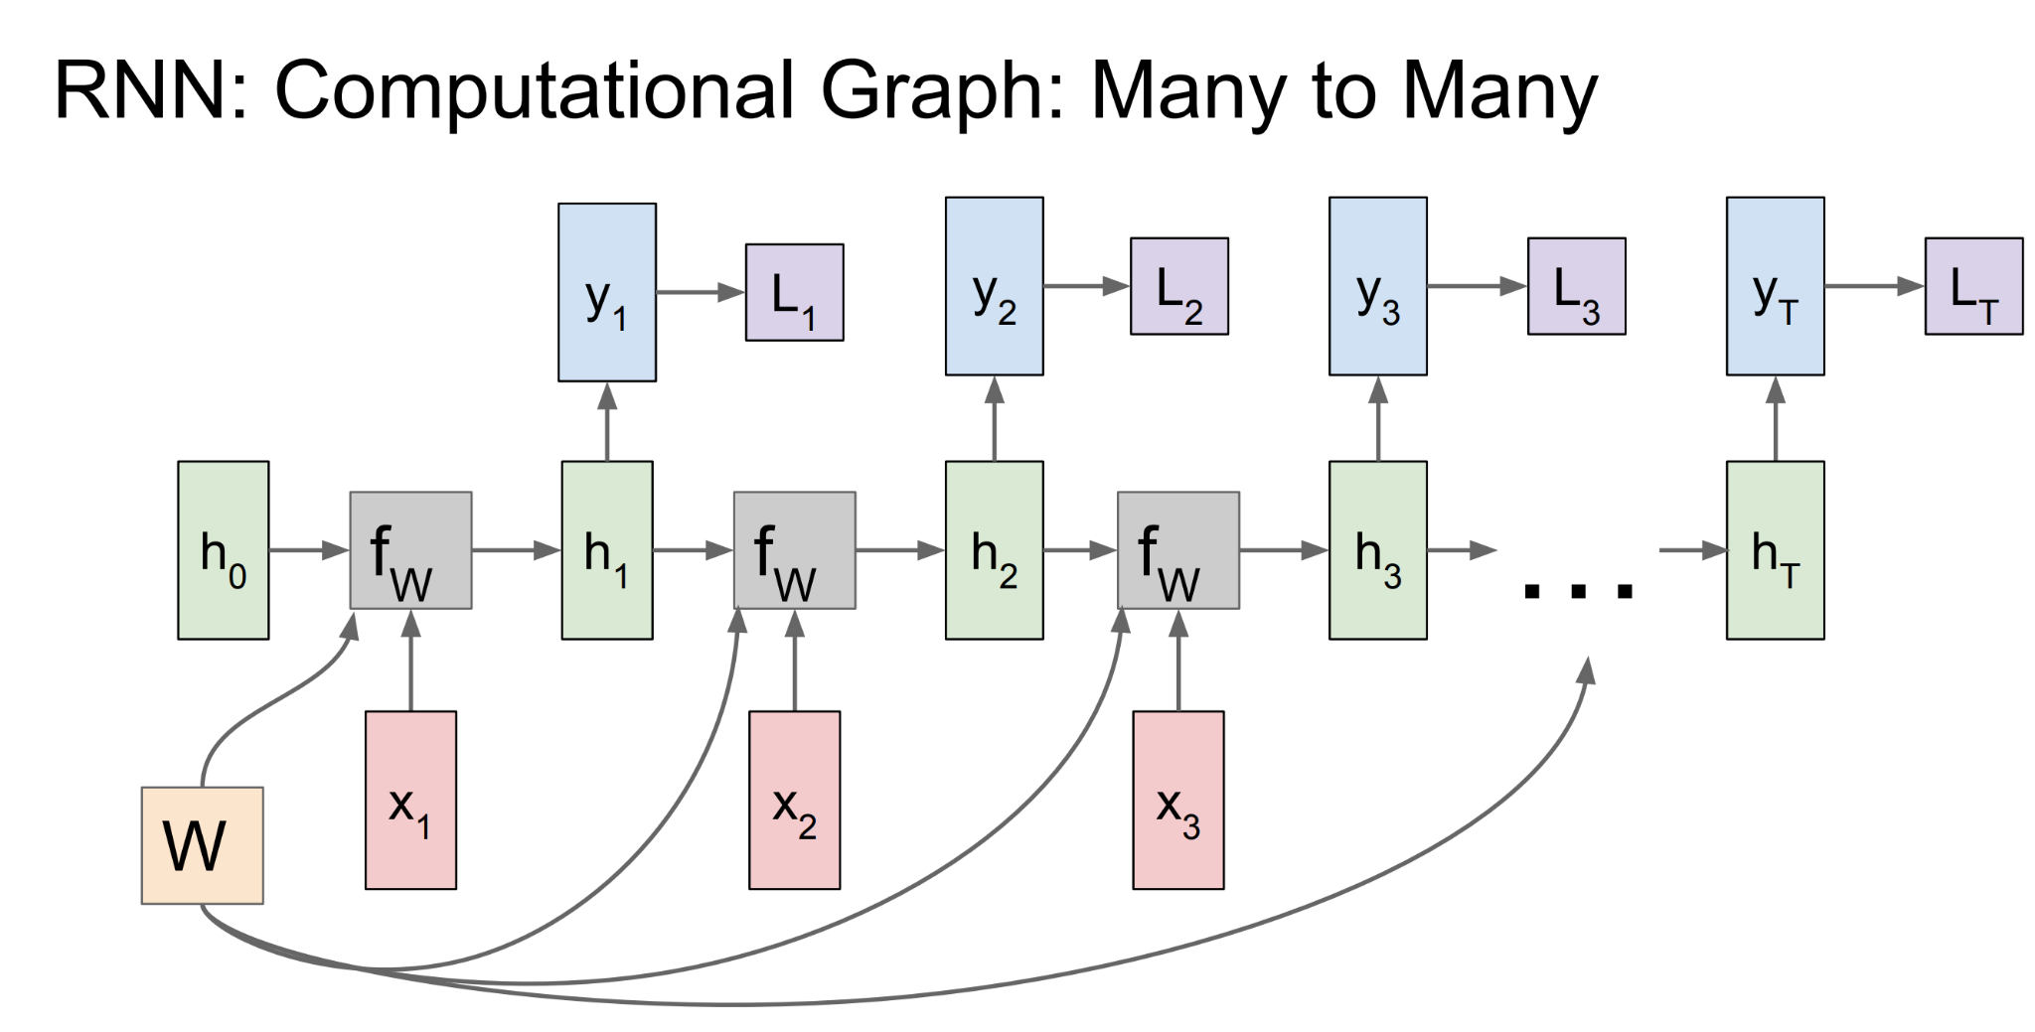
Recurrent Neural Network

Slide 23
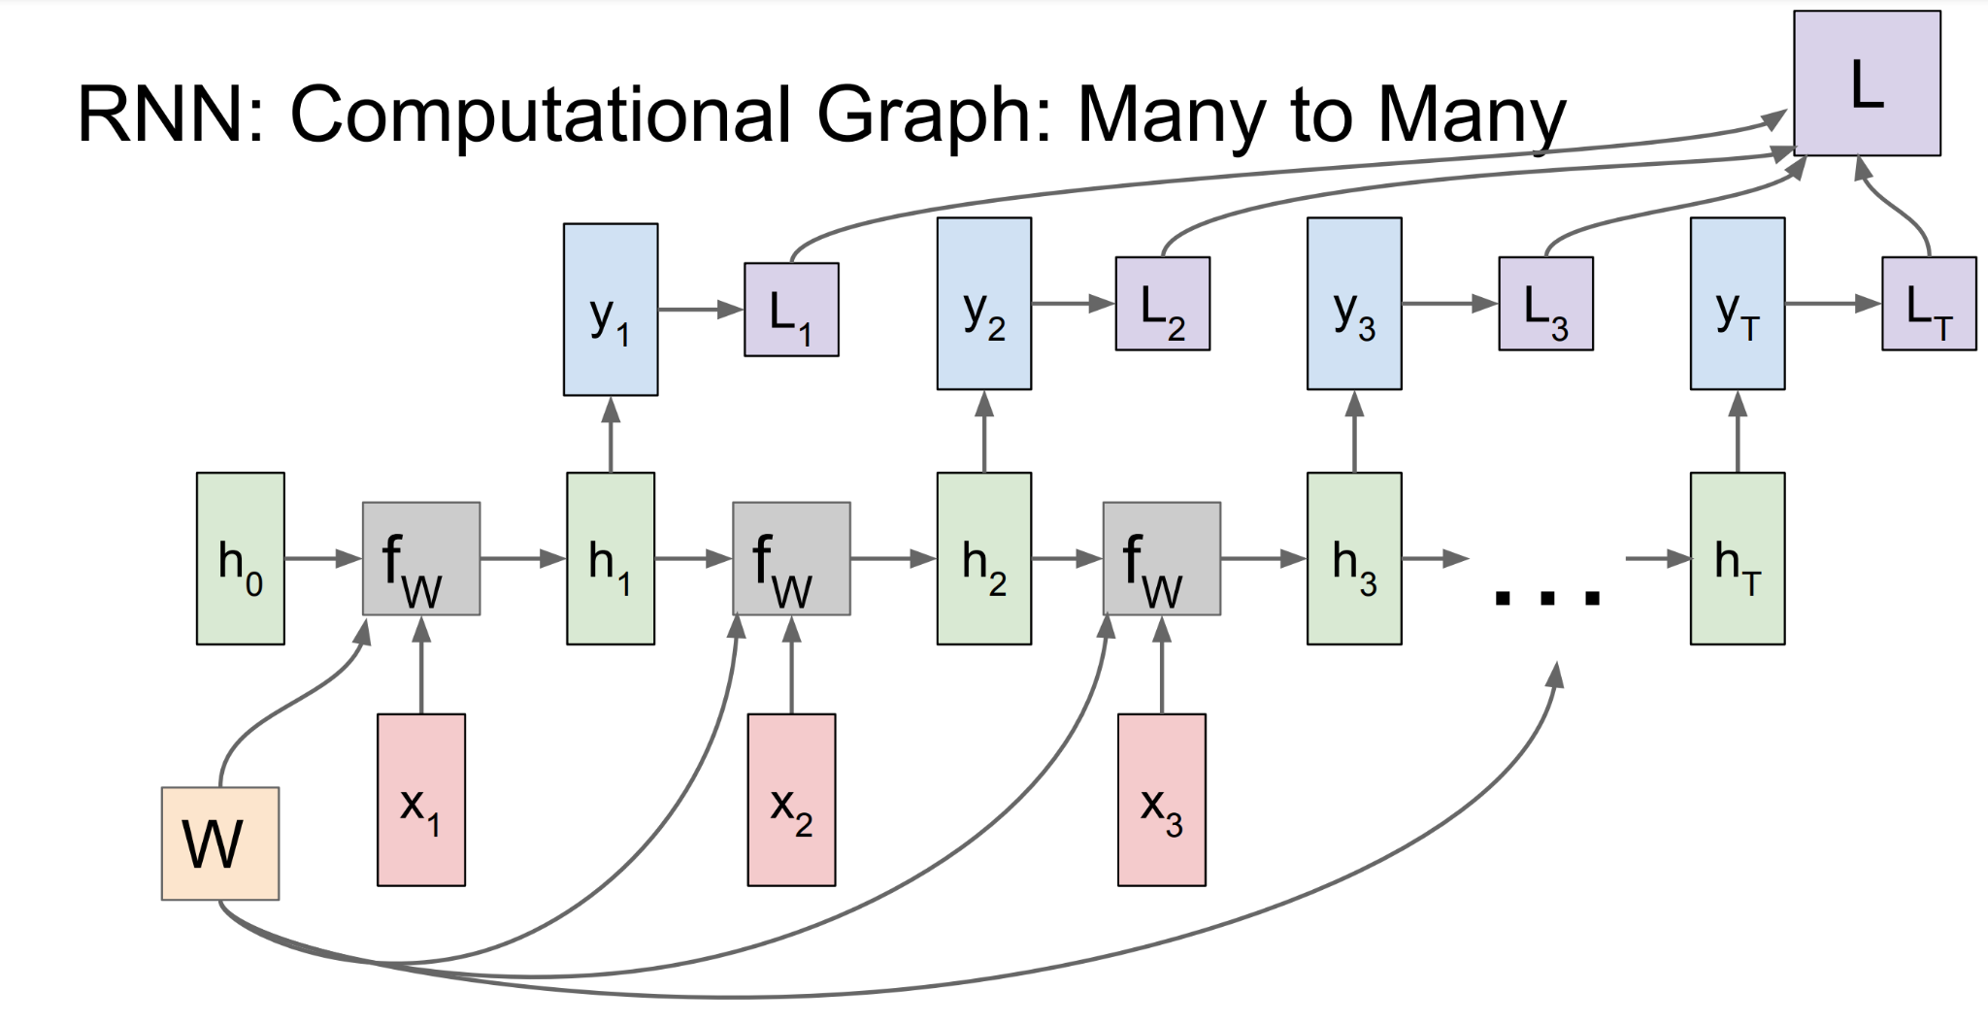
Recurrent Neural Network

Slide 24
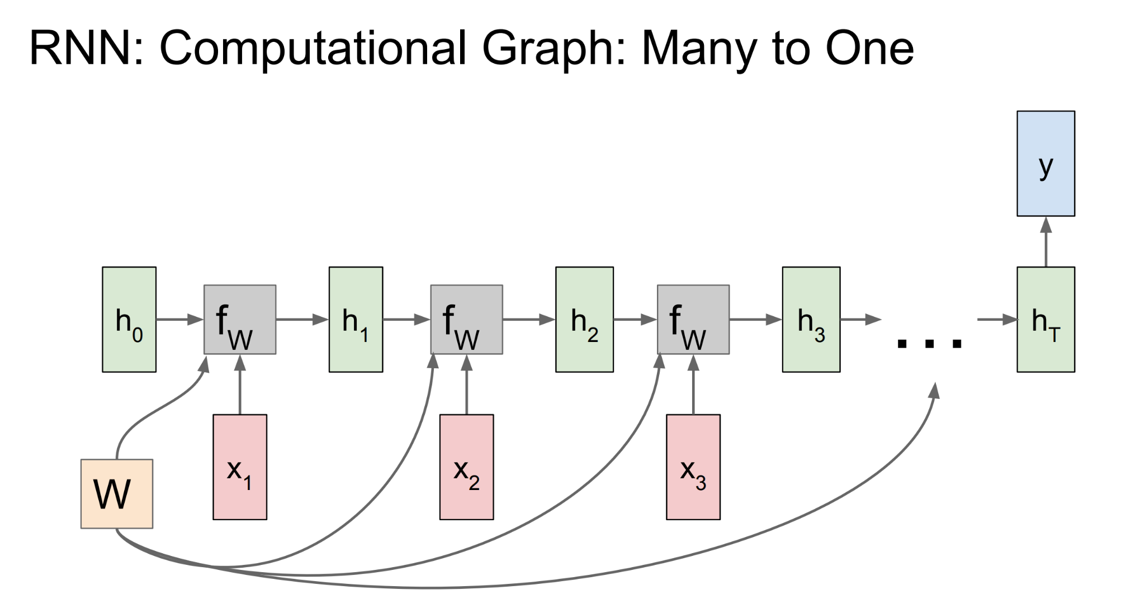
Recurrent Neural Network

Slide 25
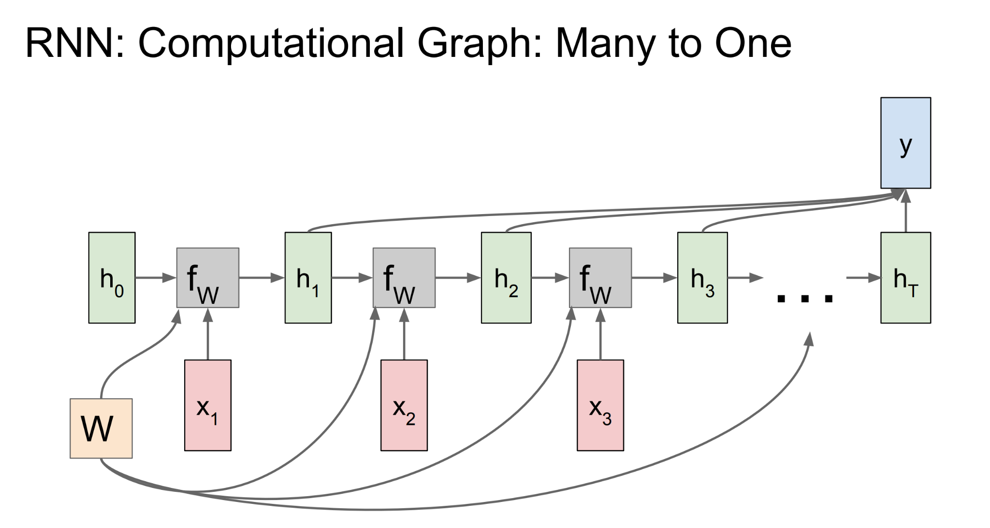
Recurrent Neural Network

Slide 26
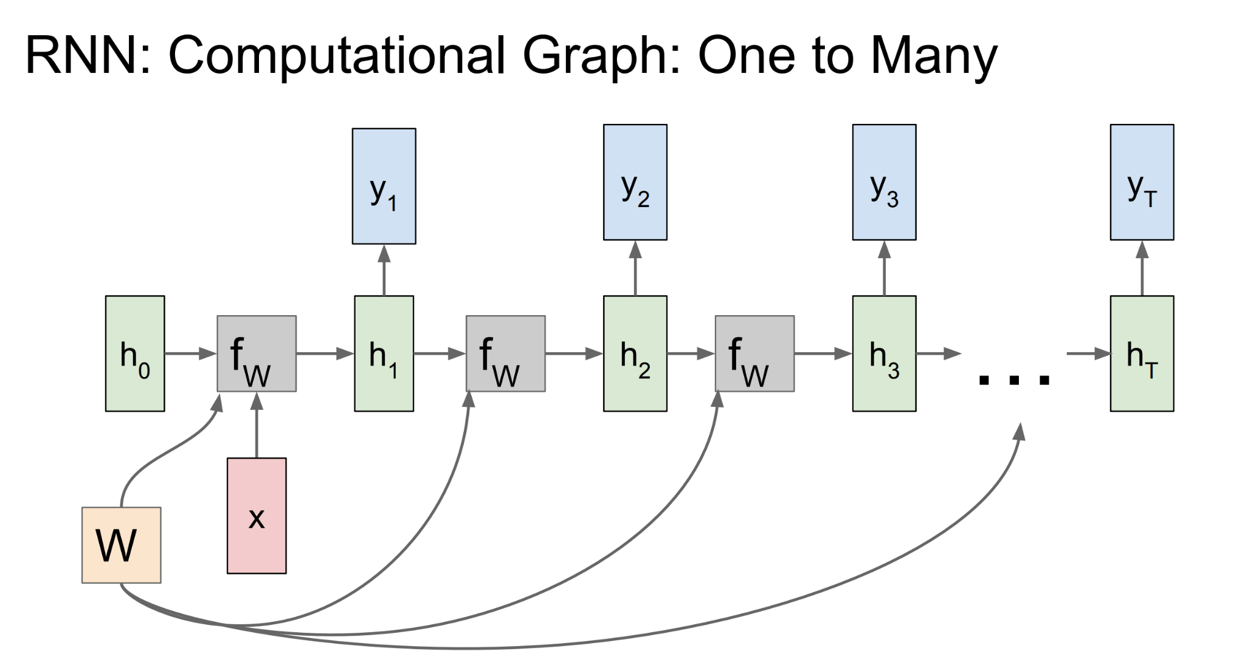
Recurrent Neural Network

Slide 27
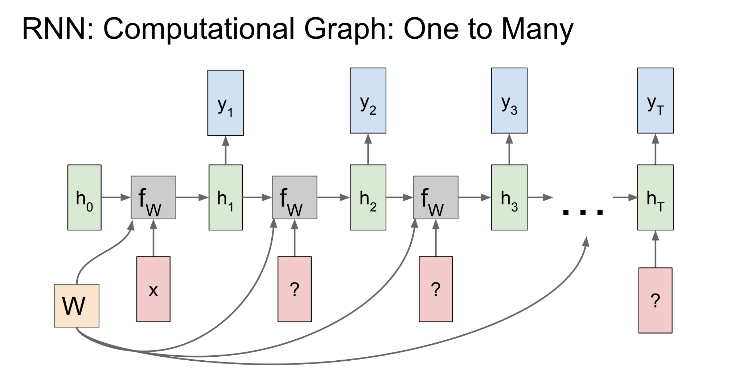
Recurrent Neural Network

Slide 28
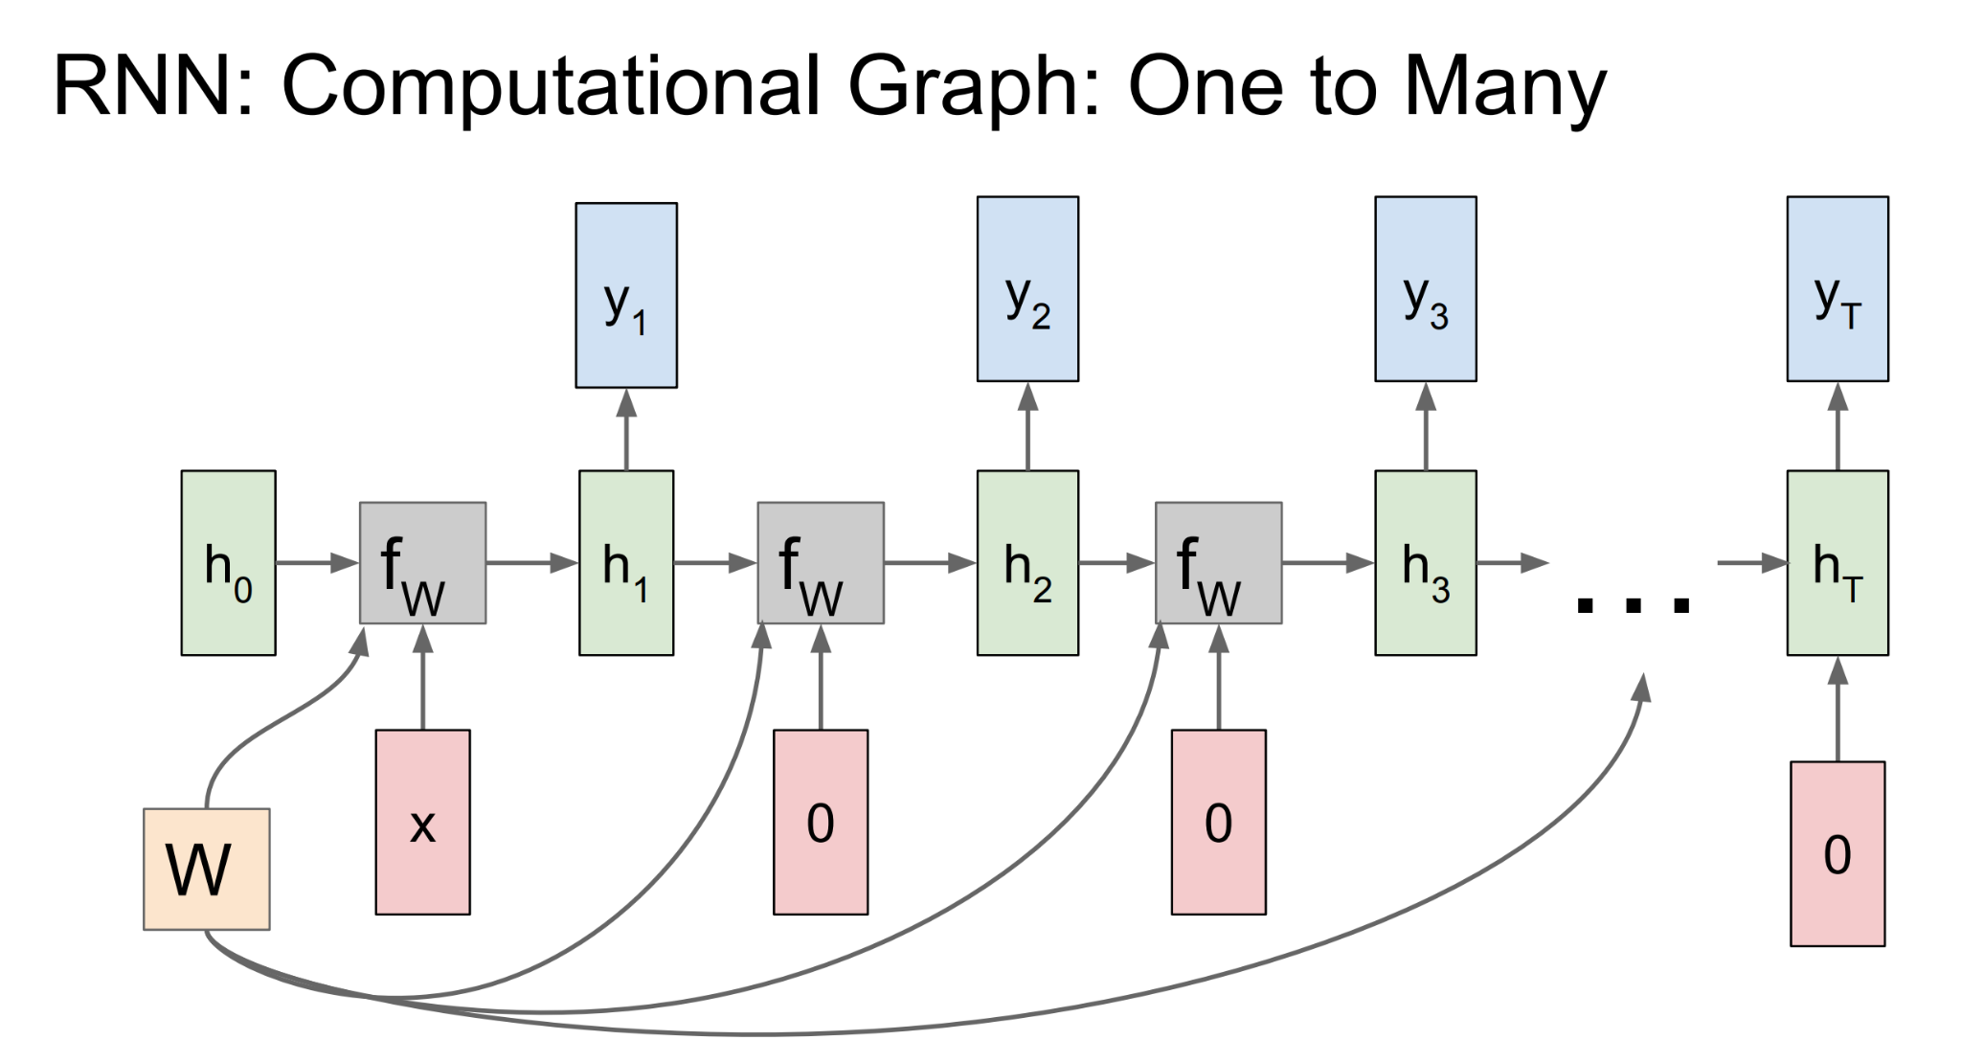
Recurrent Neural Network

Slide 29
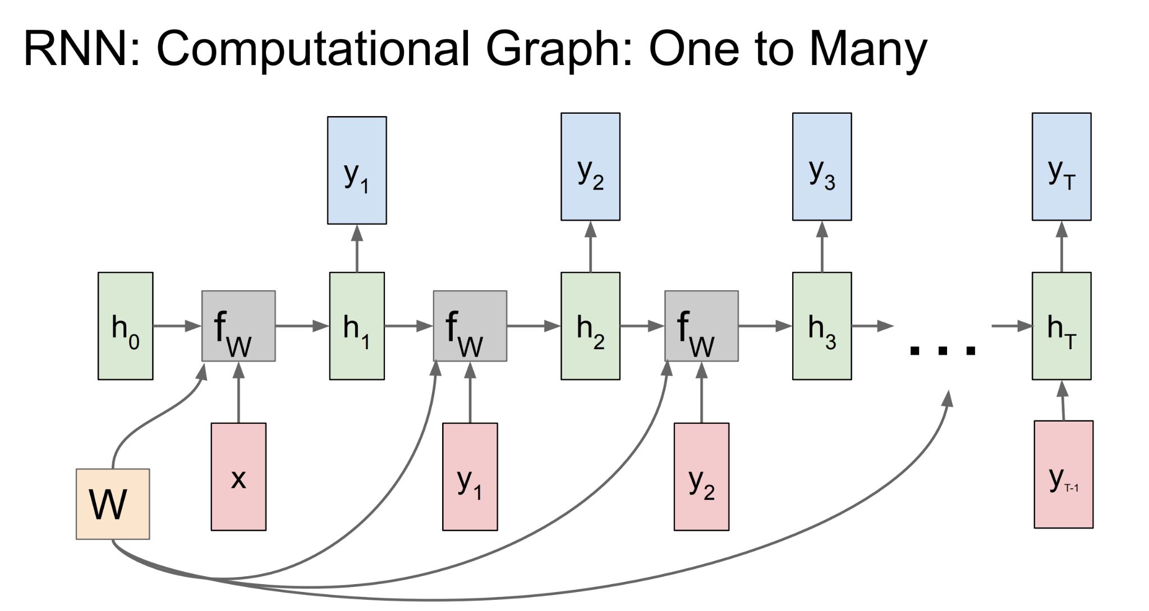
Recurrent Neural Network

Slide 30
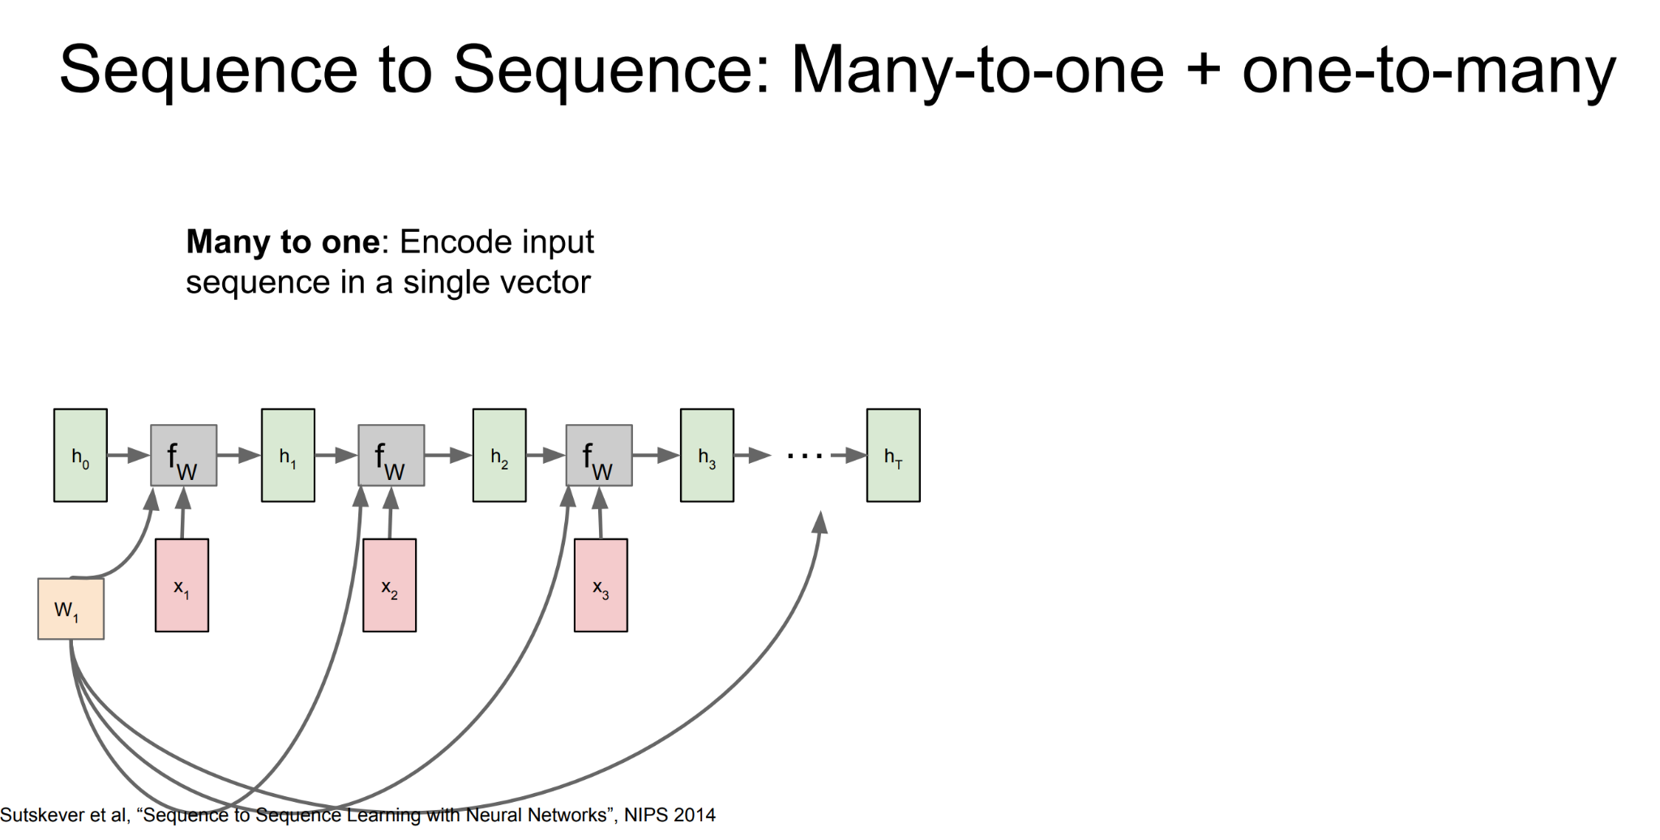
Recurrent Neural Network

Slide 31
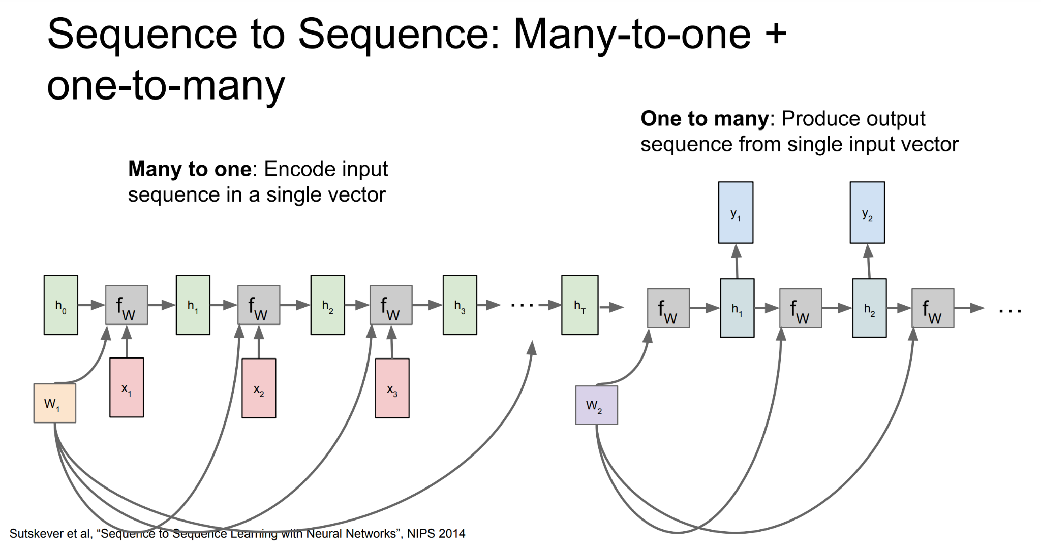
Recurrent Neural Network

Slide 32
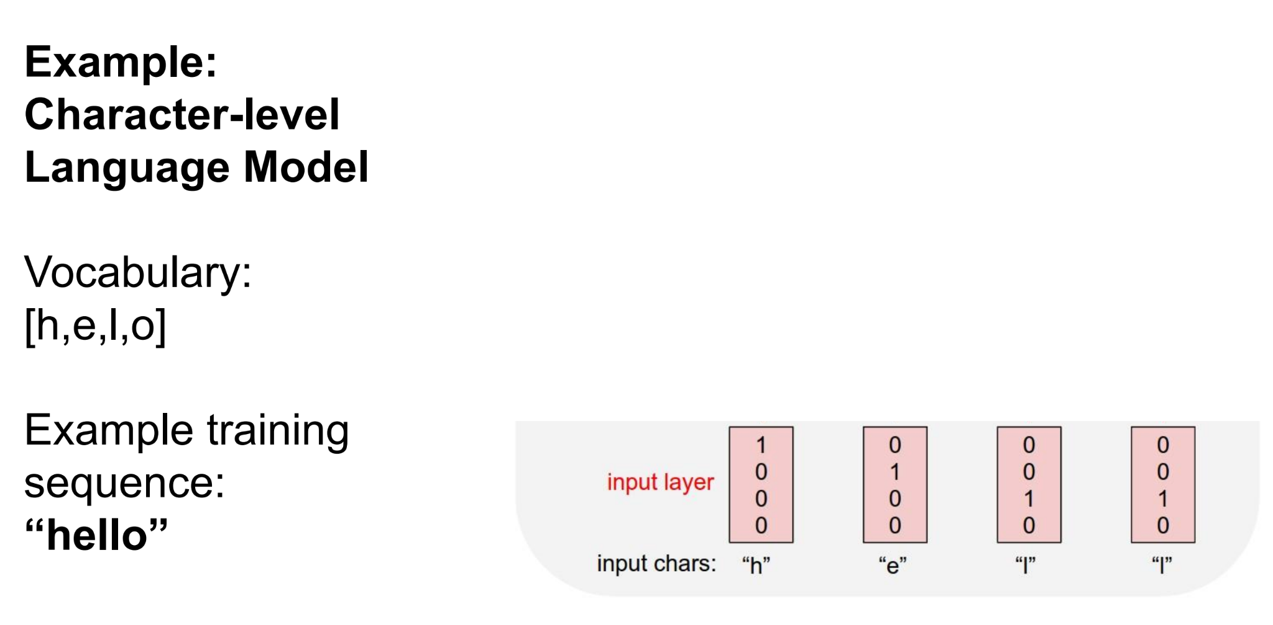
Recurrent Neural Network

Slide 33
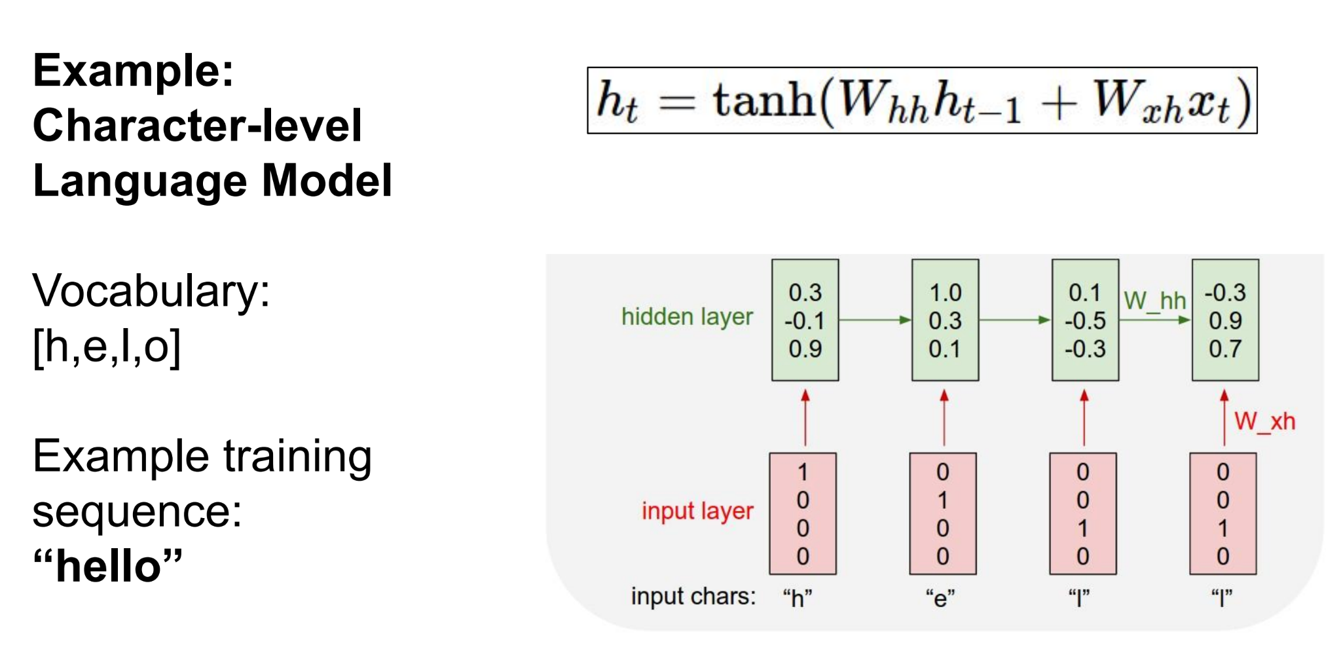
Recurrent Neural Network

Slide 34
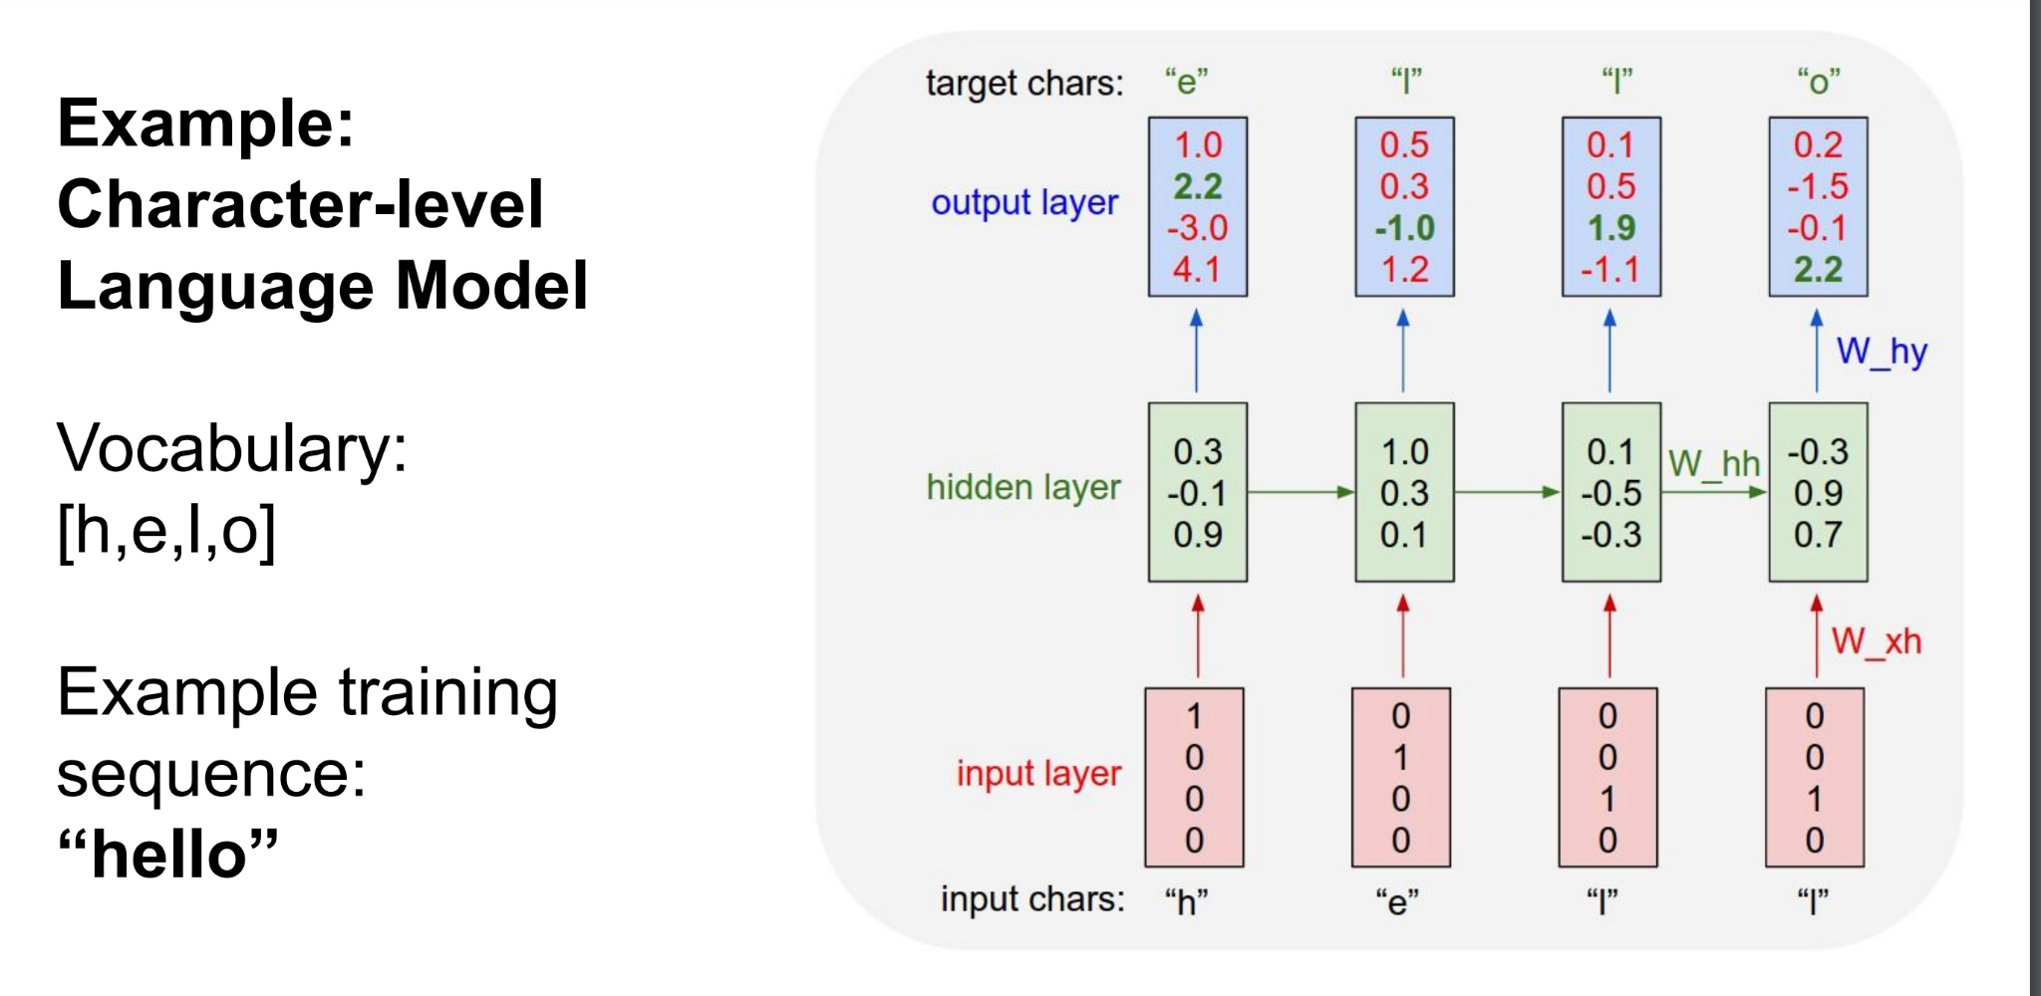
Recurrent Neural Network

Slide 35
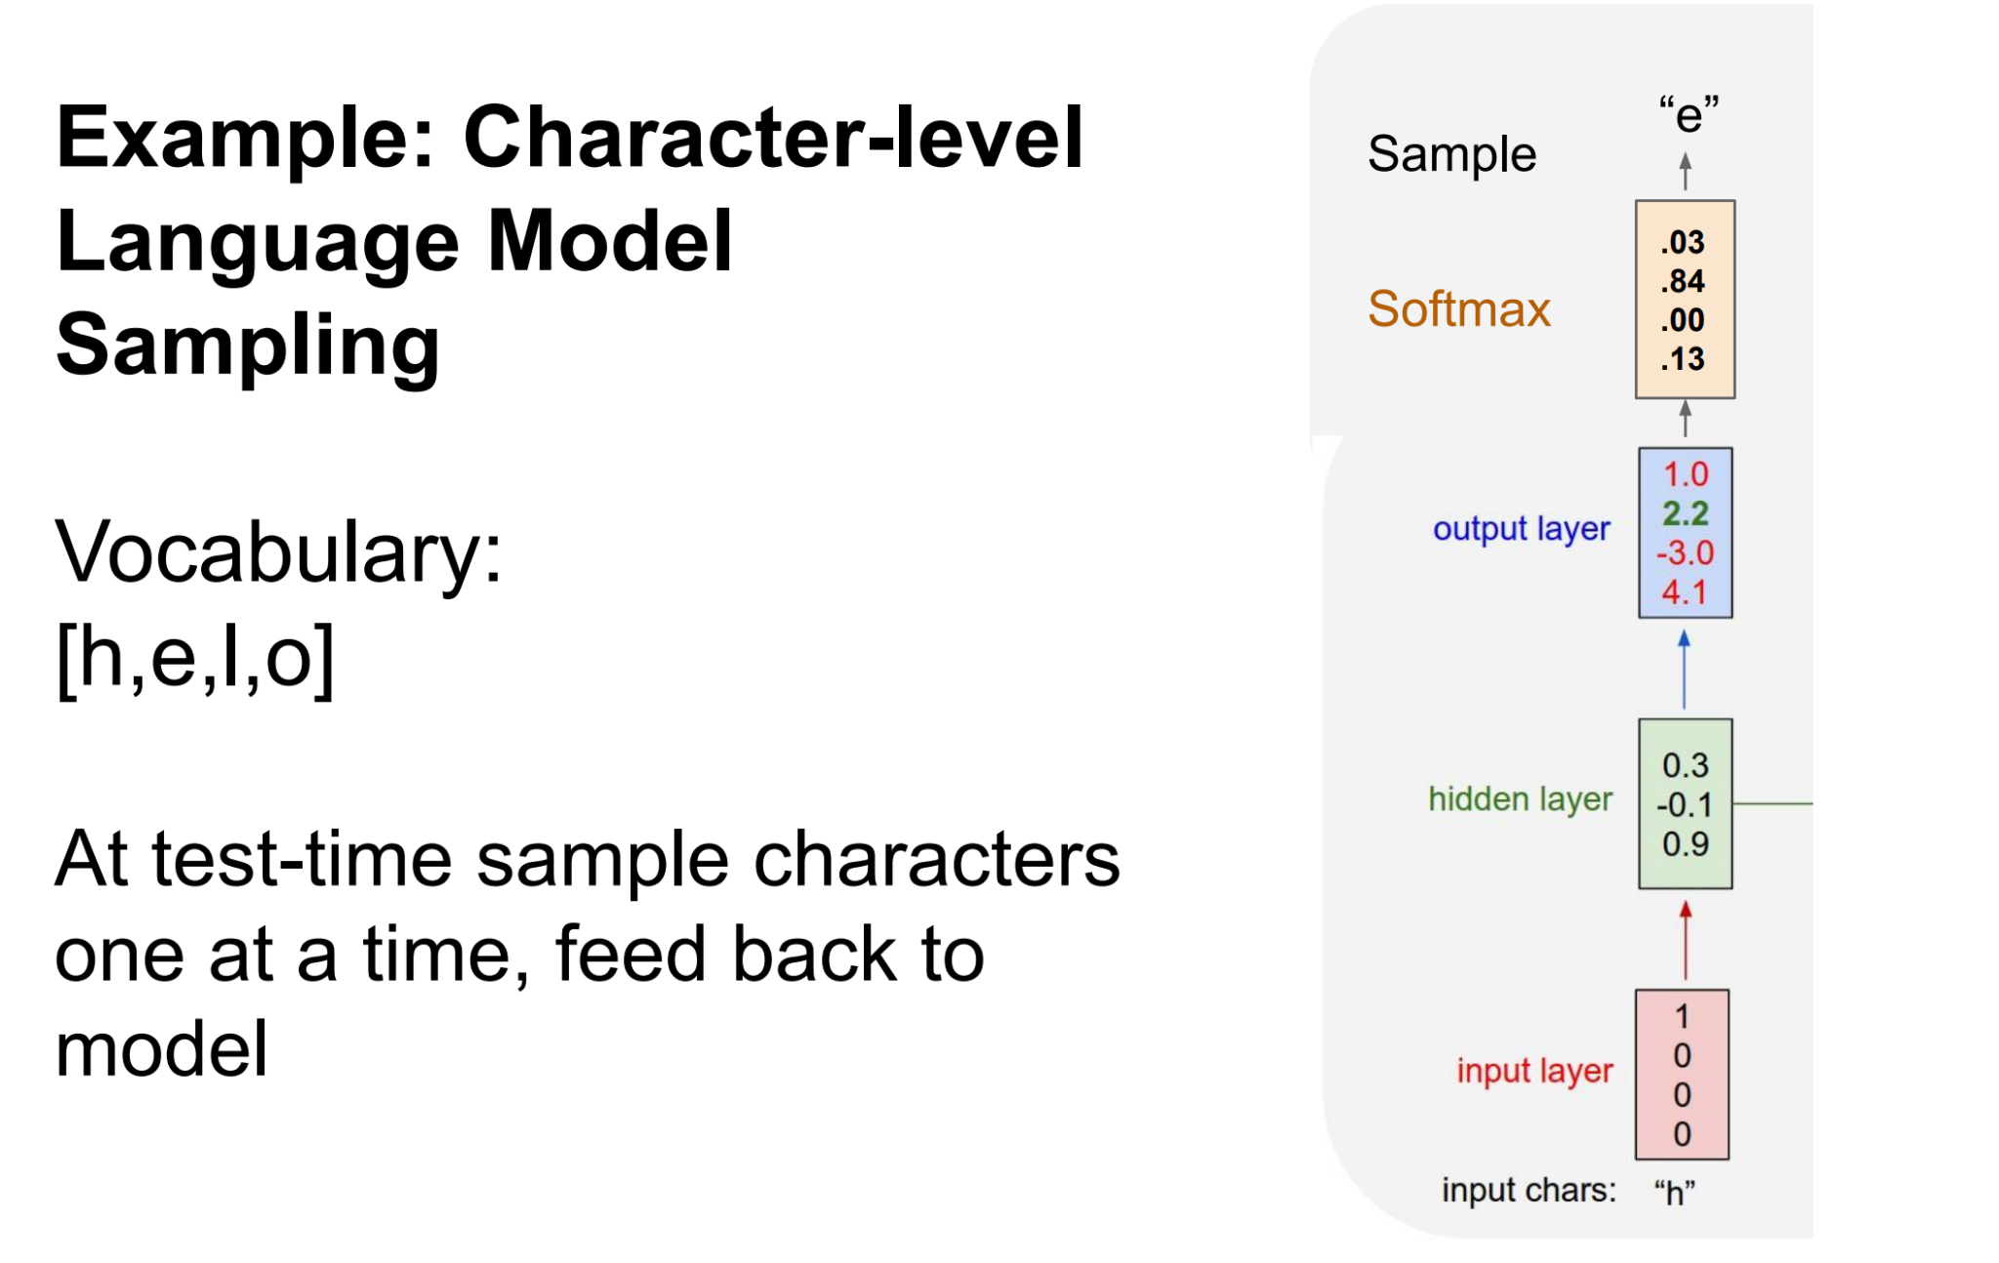
Recurrent Neural Network

Slide 36
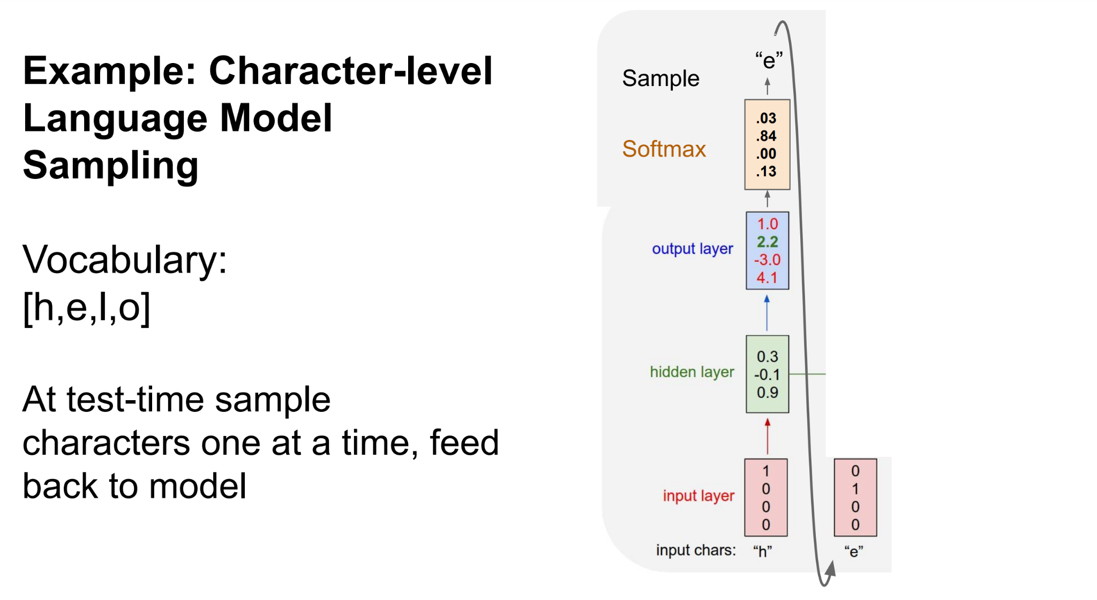
Recurrent Neural Network

Slide 37
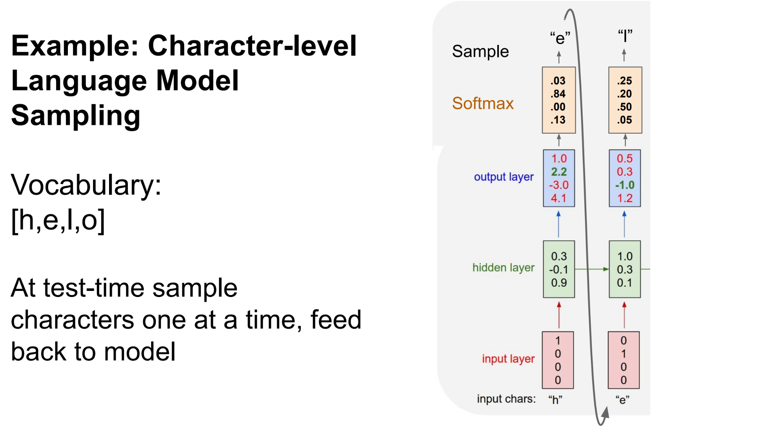
Recurrent Neural Network

Slide 38
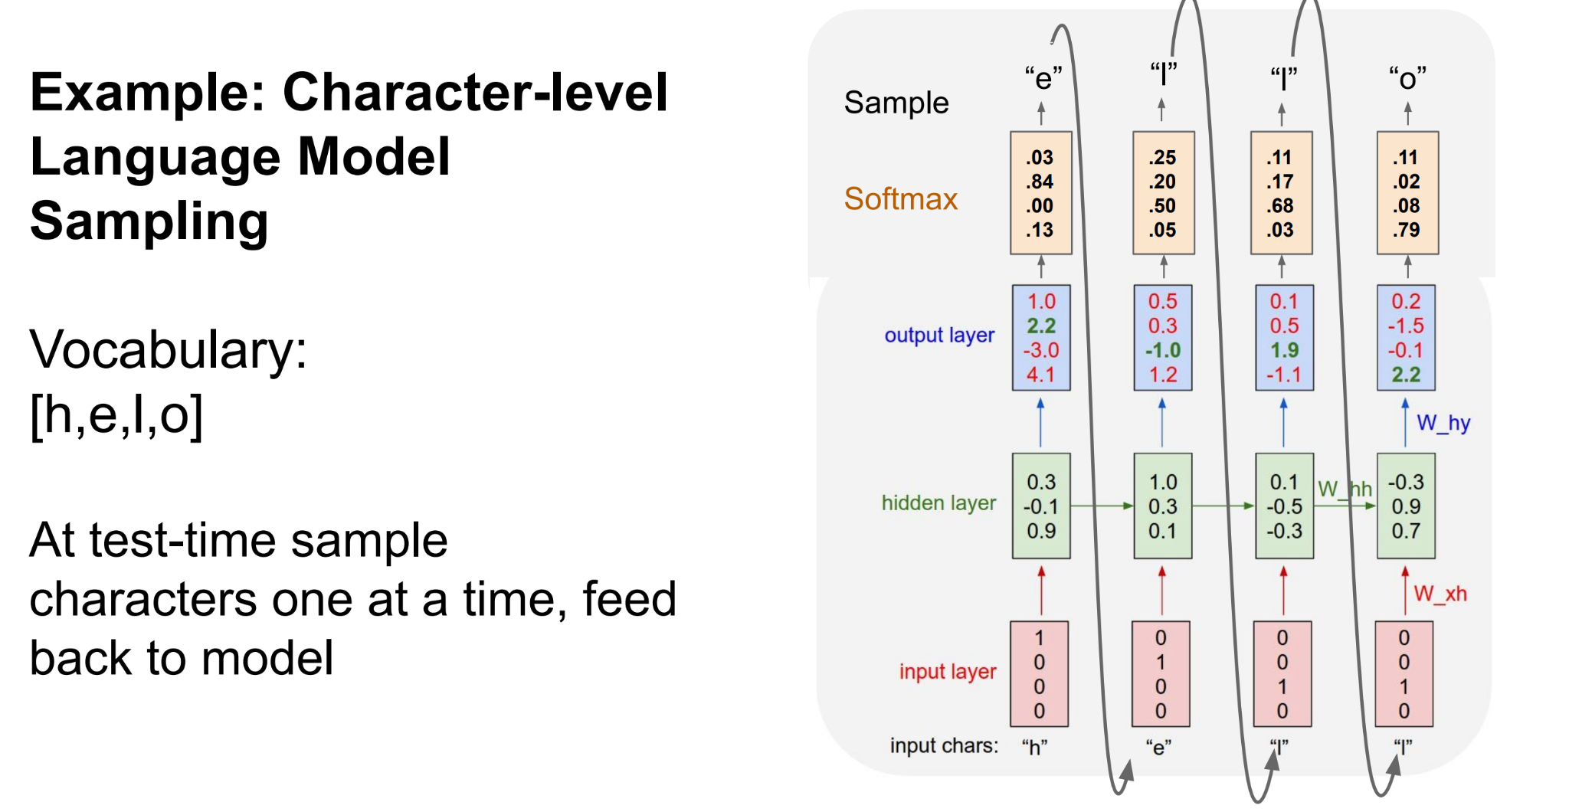
Recurrent Neural Network

Slide 39
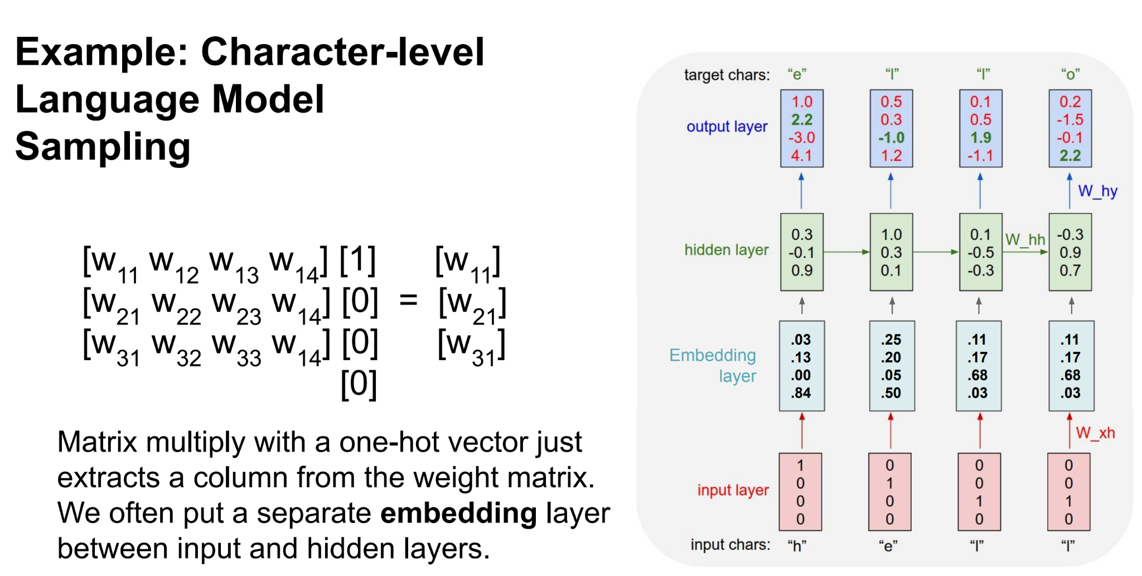
Recurrent Neural Network

Slide 40
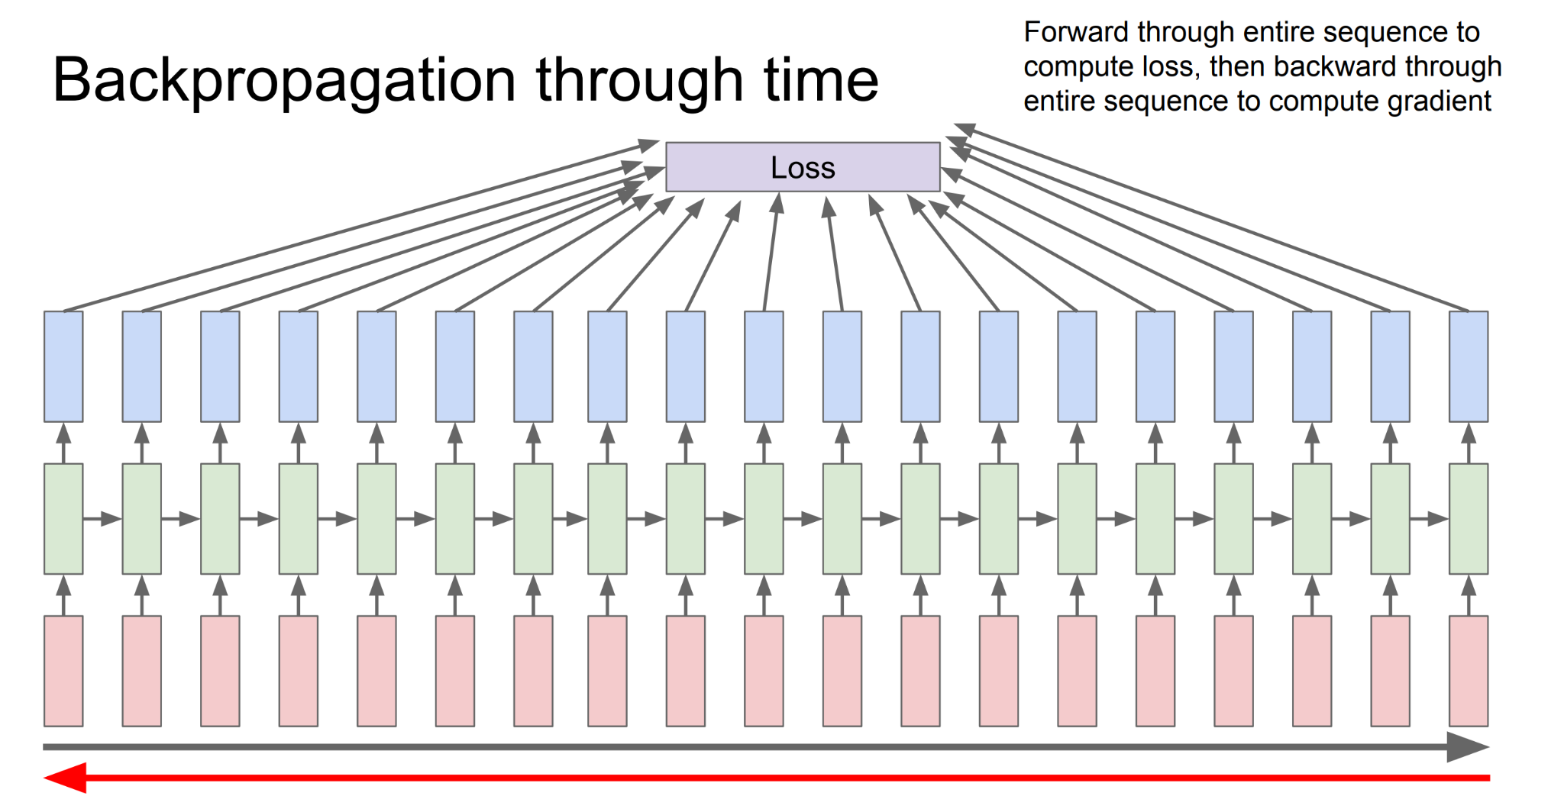
Recurrent Neural Network

Slide 41
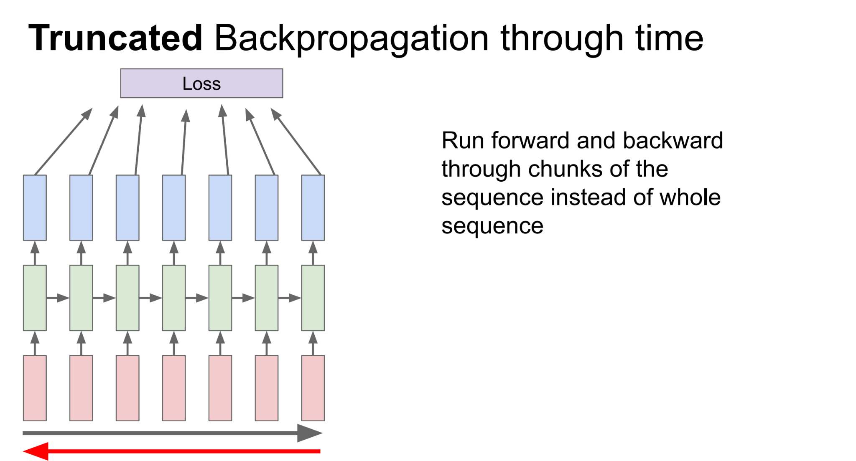
Recurrent Neural Network

Slide 42
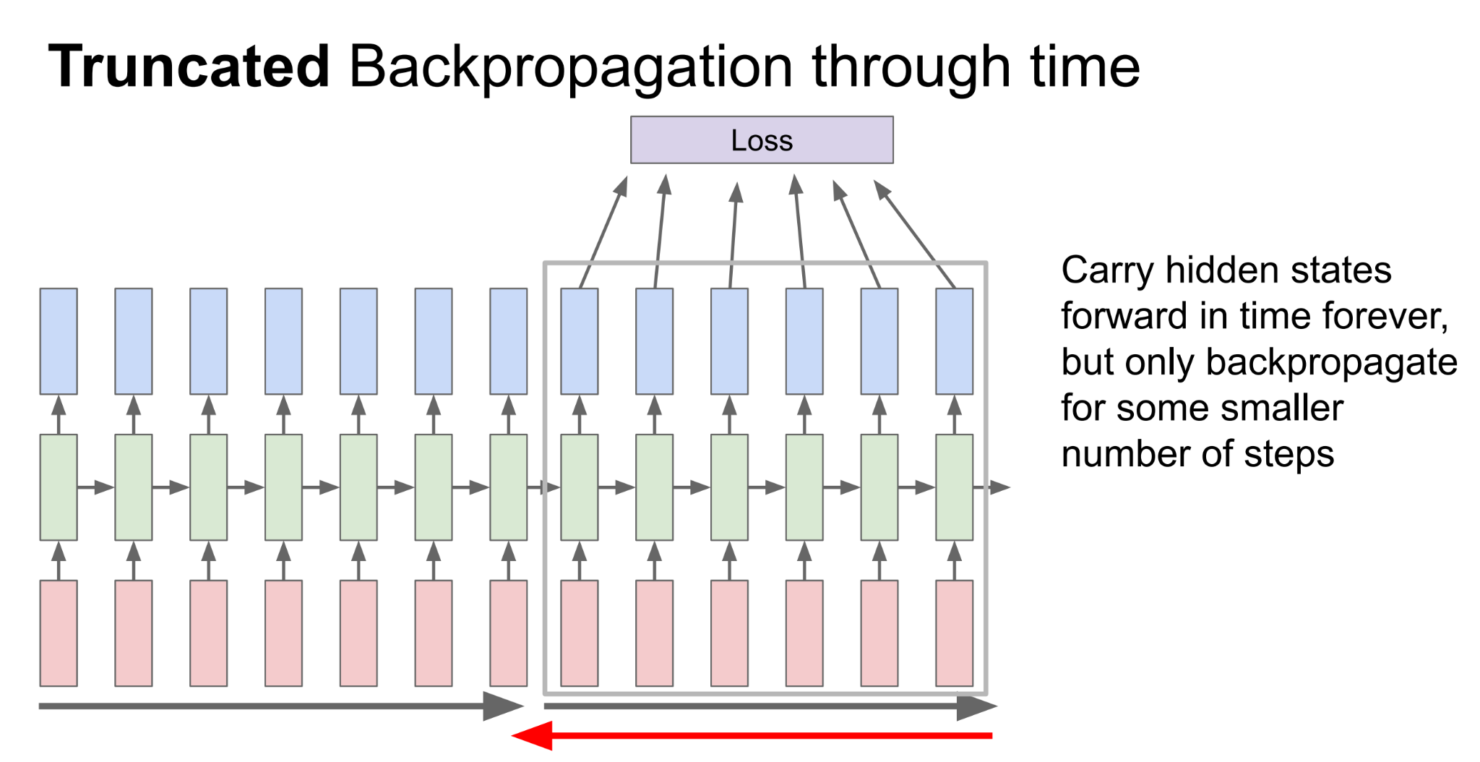
Recurrent Neural Network

Slide 43
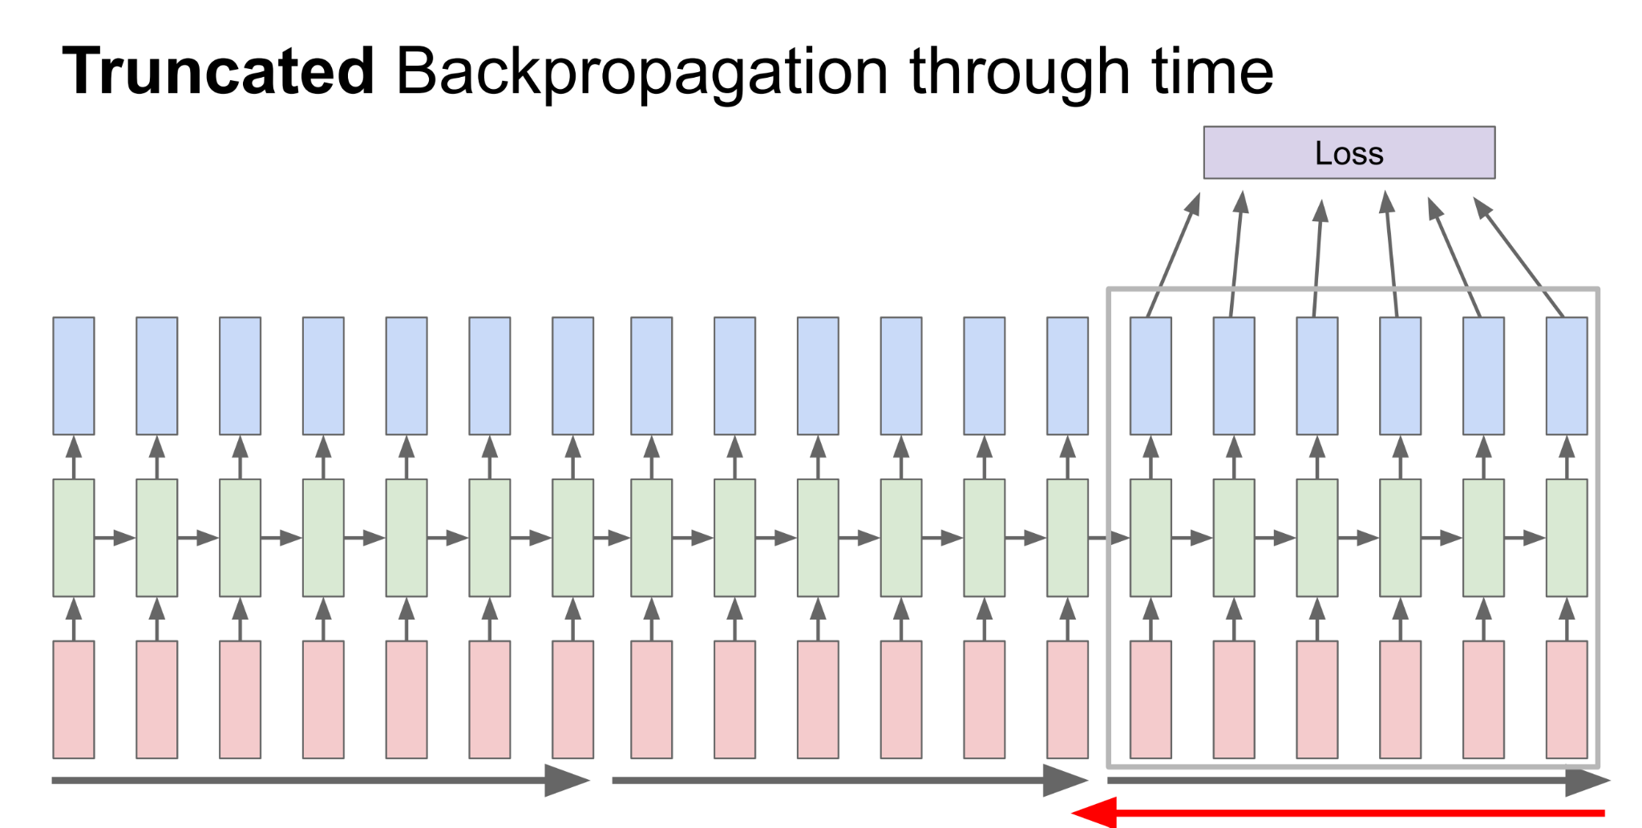
Recurrent Neural Network

Slide 44
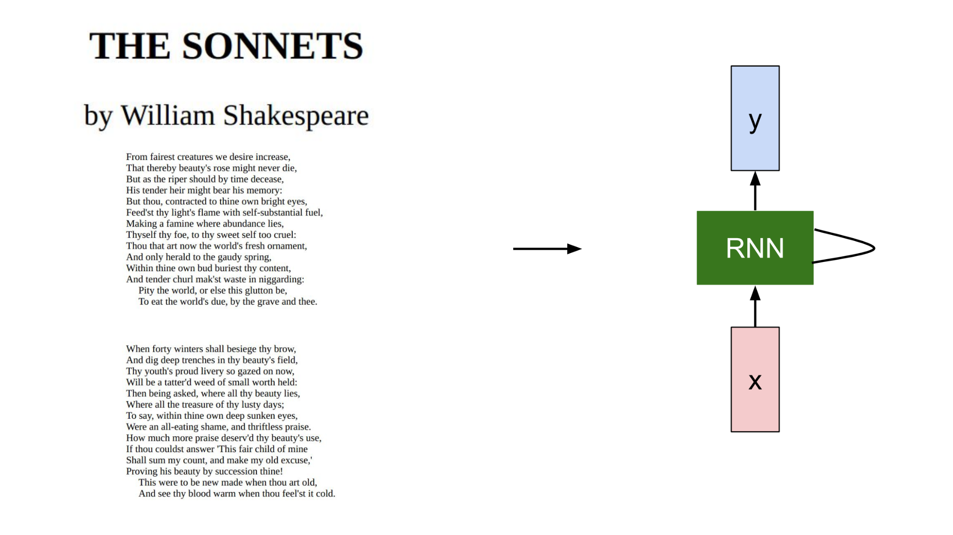
Recurrent Neural Network

Slide 45
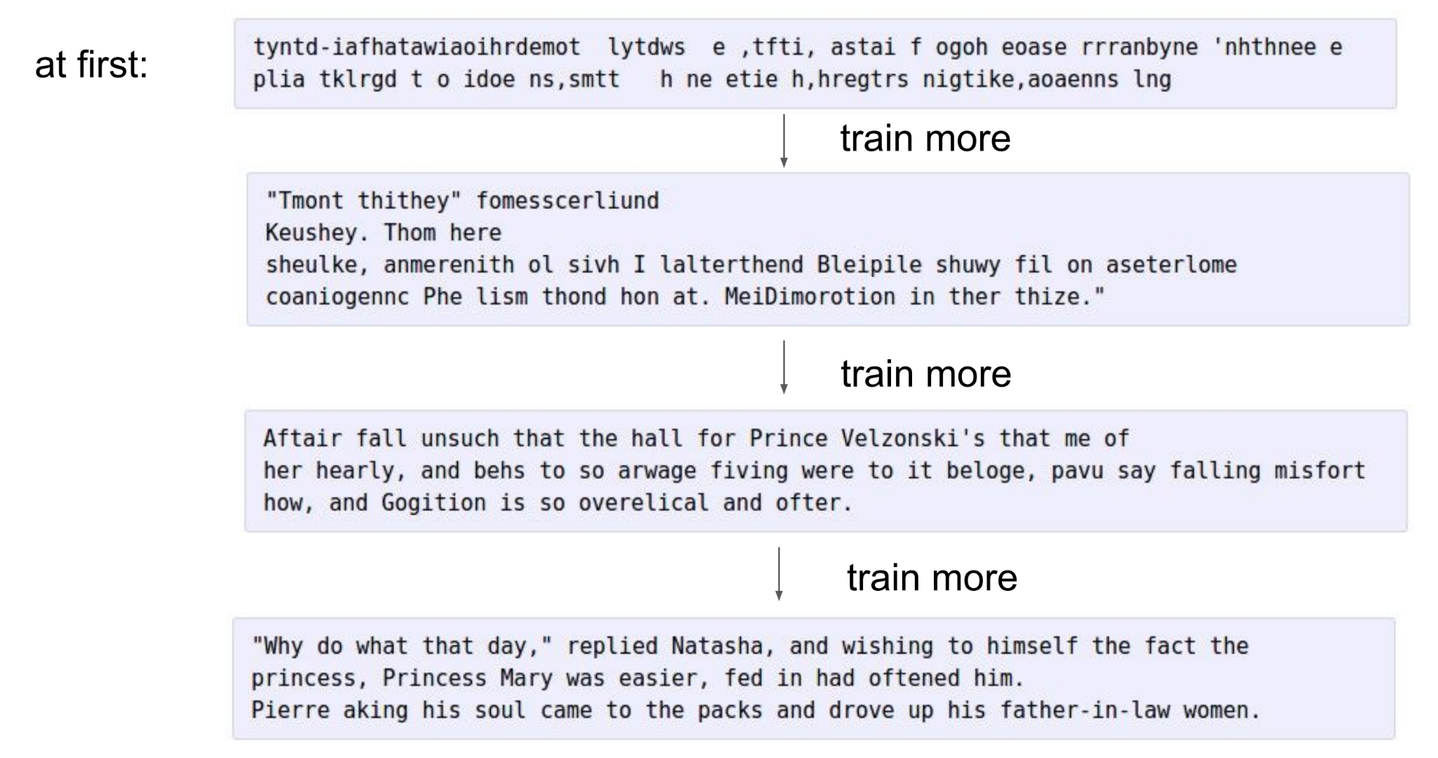
Recurrent Neural Network

Slide 46
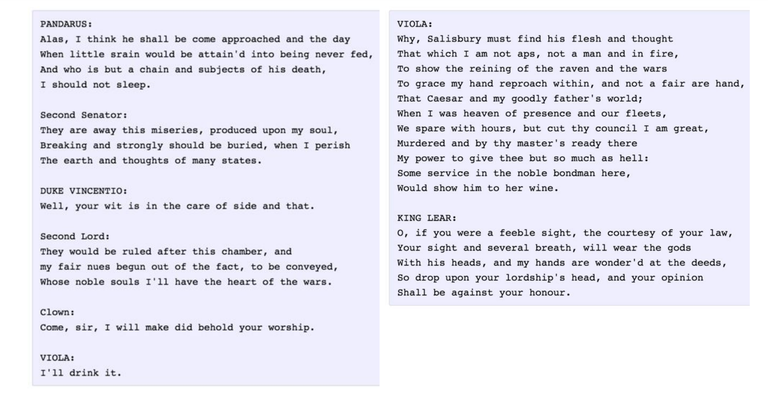
Recurrent Neural Network

Slide 47
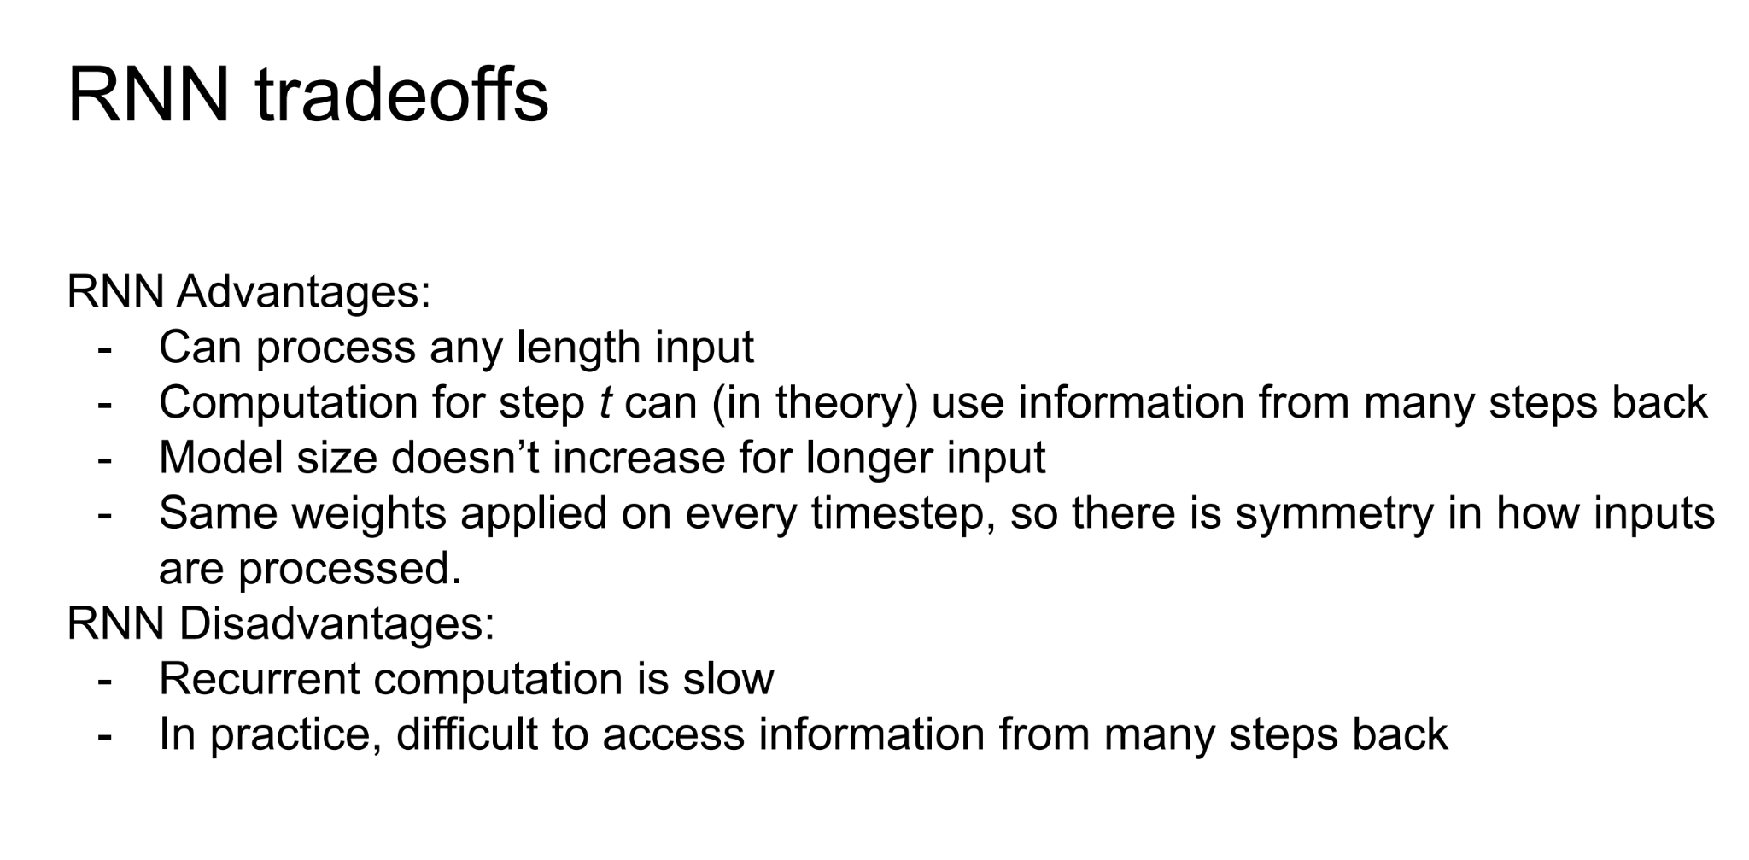
Recurrent Neural Network

Slide 48
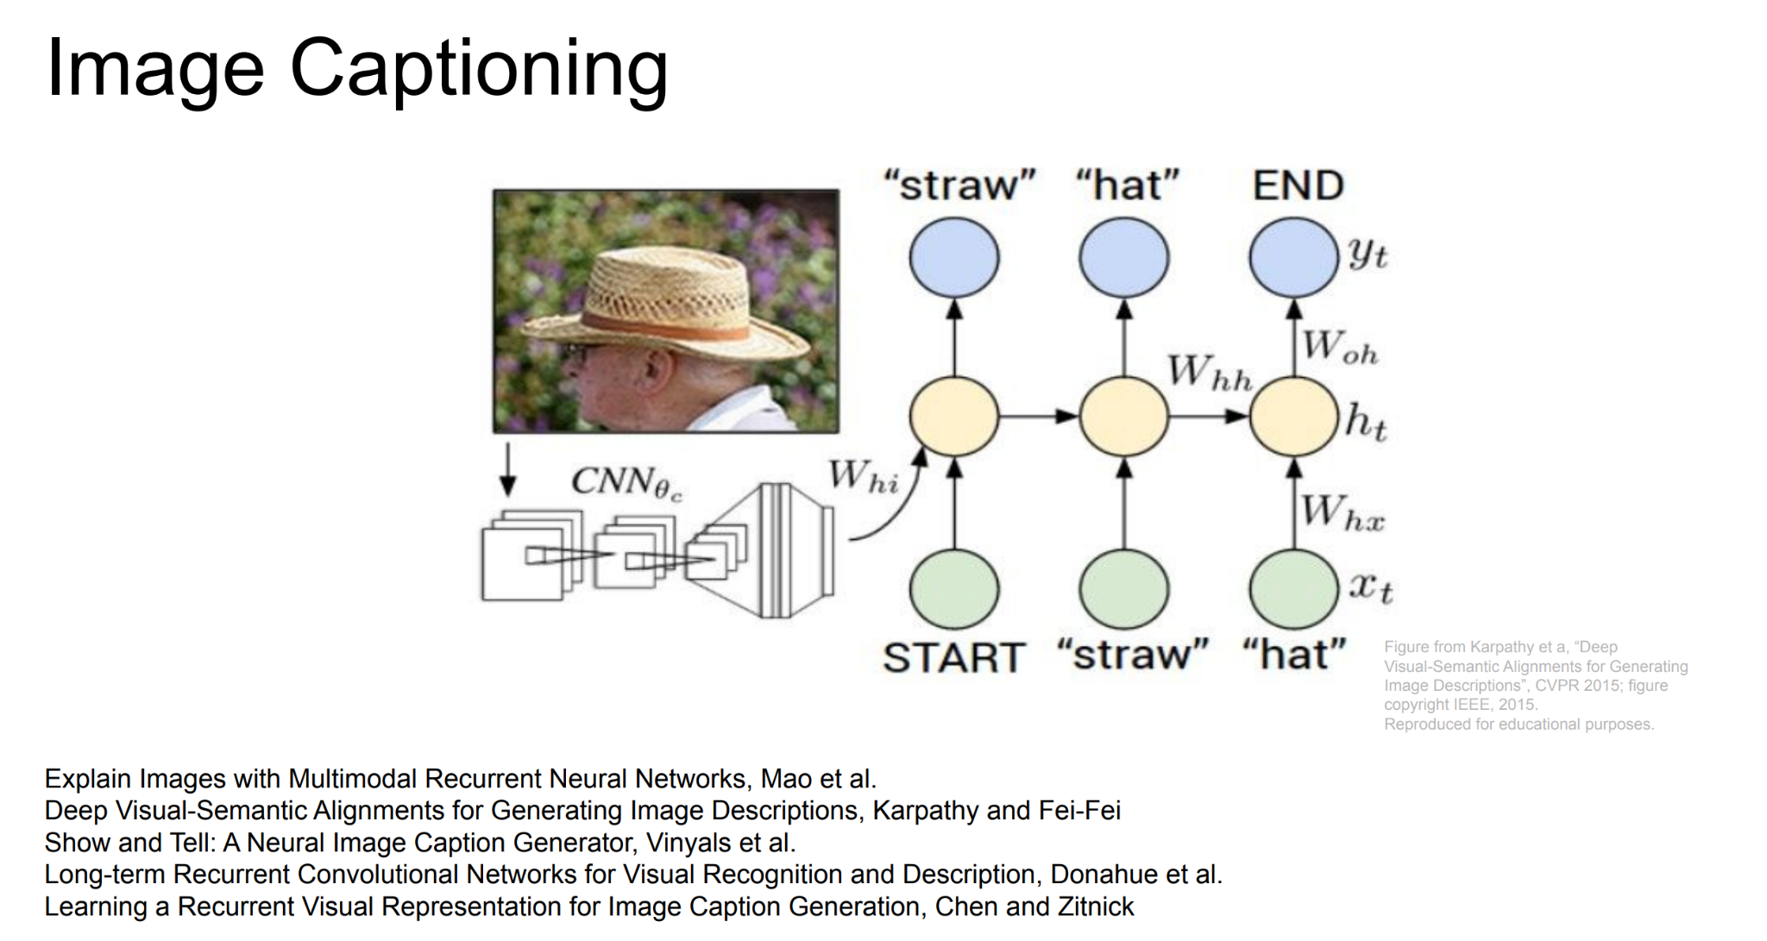
Recurrent Neural Network

Slide 49
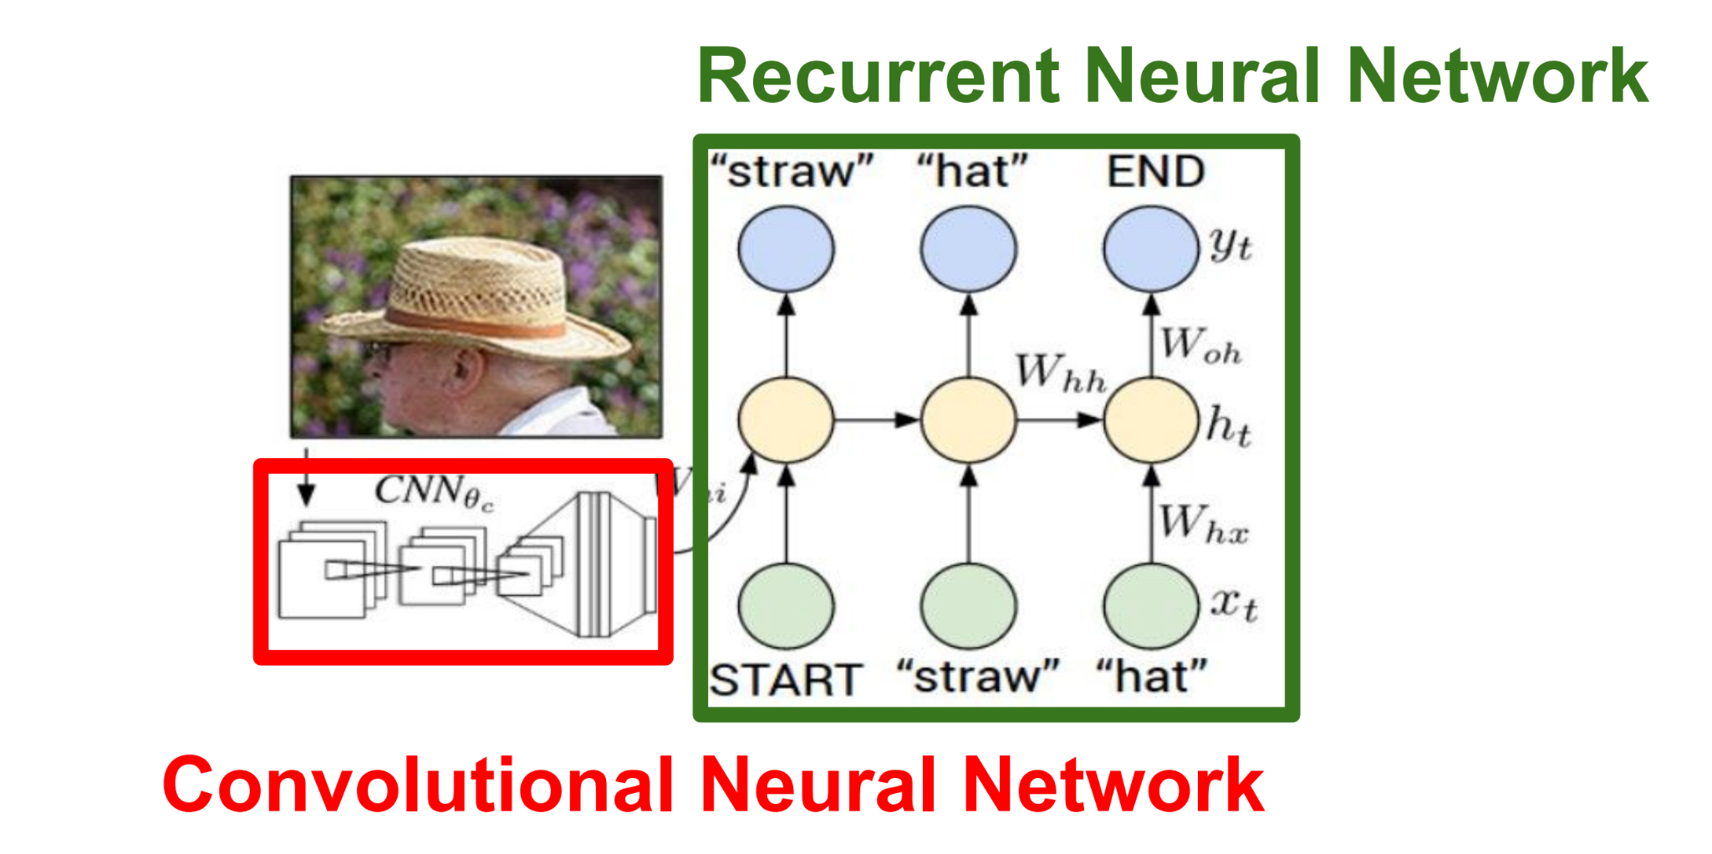
Recurrent Neural Network

Slide 50
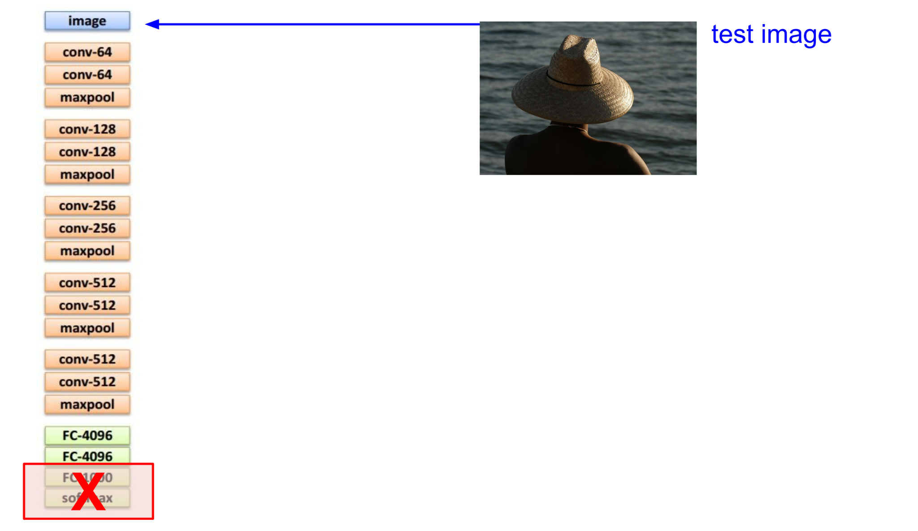
Recurrent Neural Network

Slide 51
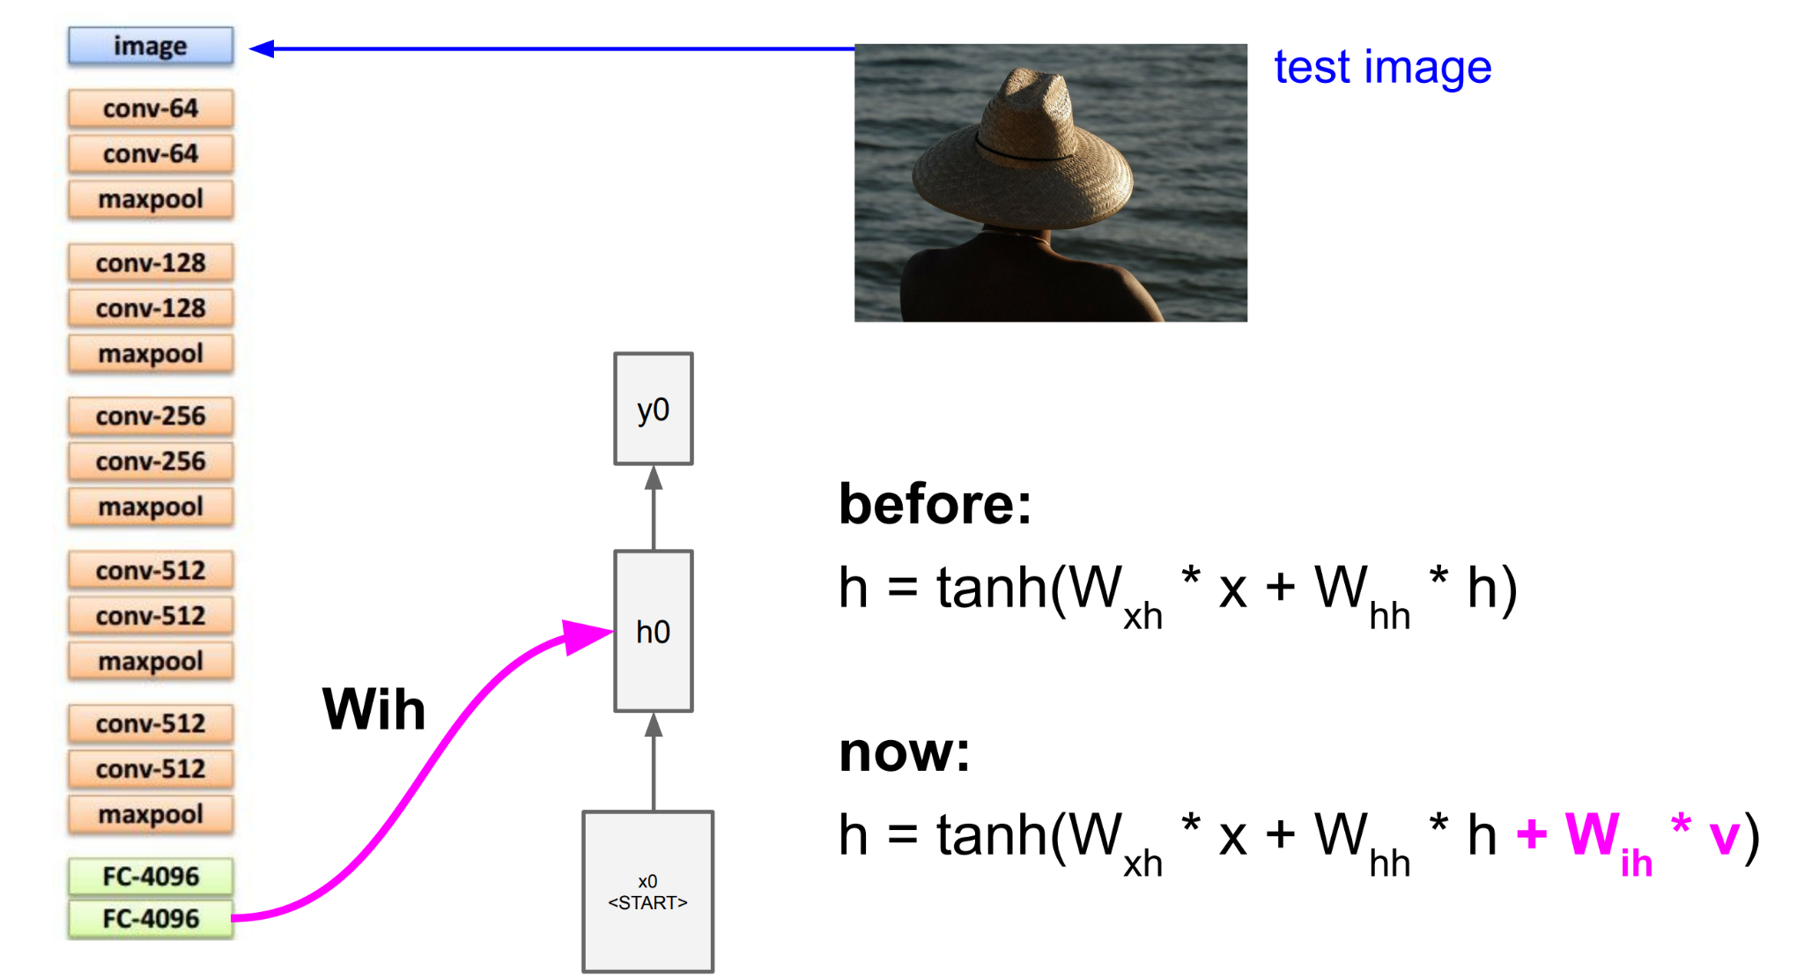
Recurrent Neural Network

Slide 52
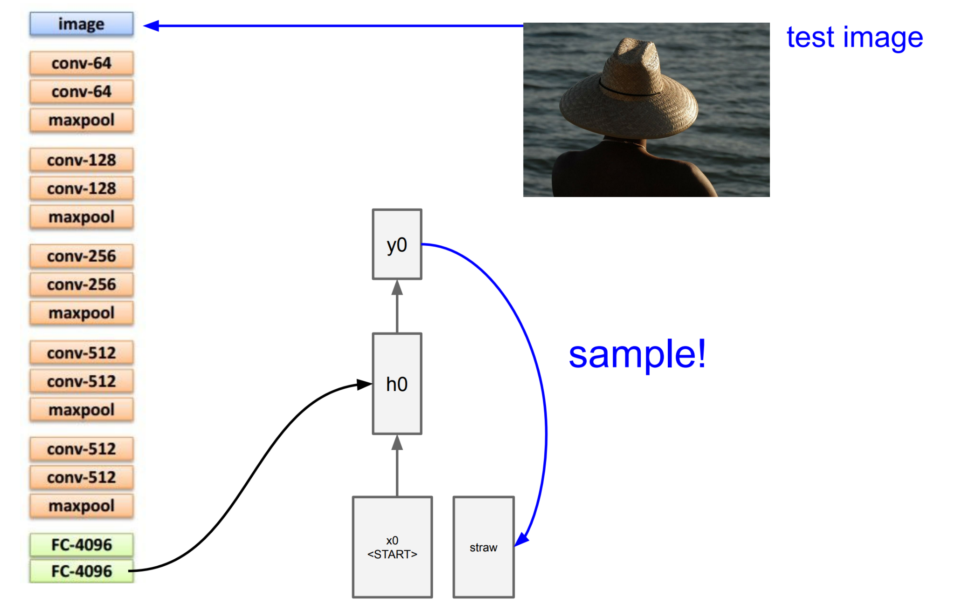
Recurrent Neural Network

Slide 53
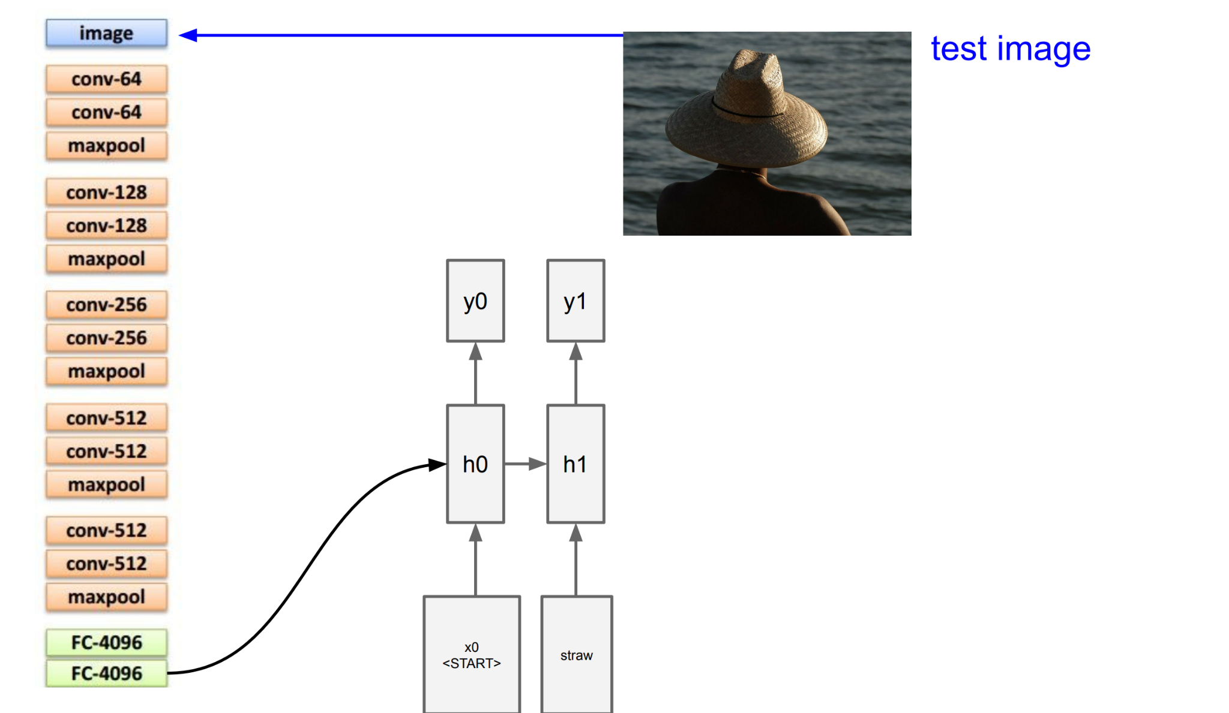
Recurrent Neural Network

Slide 54

Recurrent Neural Network

Slide 55

Recurrent Neural Network

Slide 56

Recurrent Neural Network

Slide 57
Questions?
Sai Karthik Garnepudi
saikarthik.garnepudi@wichita.edu
Dr.Shruti Kshirsagar
Kshirsagarshruti1@gmail.com

Slide 58
References
1.

Slide 59
Questions:
Overfitting
CNN layers
weight Initialization methods
Learning rate - too small or too large

Slide 60
Next class
Recurrent Neural Network

